Slide 1
Chaos and The Lorenz Equations
Numeric Solutions:
Global Behaviour
The effect of varying r on the time evolution of the system
Poincaré Sections

Slide 2
Code Used:
import matplotlib.pyplot as pt
from scipy import integrate
import numpy as np
from mpl_toolkits.mplot3d import Axes3D
pt.rcParams.update({'font.size': 8})
a=100
def lorenz(vec, t0, s=10, b=8/3, r=a):
(x,y,z)=vec
return [s*(y-x), x*(r-z)-y, x*y-b*z]
# starting point
x_0 = [1,0,0]
x_1 = [0,-1,a-1]
ti=0
tf=25
nsteps=10000
t = np.linspace(ti, tf, nsteps)
xt_0 = integrate.odeint(lorenz, x_0, t)
xt_1 = integrate.odeint(lorenz, x_1, t)
j_0=[row[0] for row in xt_0]
k_0=[row[1] for row in xt_0]
l_0=[row[2] for row in xt_0]
j_1=[row[0] for row in xt_1]
k_1=[row[1] for row in xt_1]
l_1=[row[2] for row in xt_1]
fig = pt.figure()
ax = fig.gca(projection='3d')
ax.set_xlabel('X')
ax.set_ylabel('Y')
ax.set_zlabel('Z')
ax.plot(j_0,k_0,l_0, 'g', linewidth=0.2, label=x_0)
ax.plot(j_1,k_1,l_1, 'r', linewidth=0.2, label=x_1)
ax.plot([1,0],[0,-1], [0,a-1], 'bx', markersize=5)
ax.legend()
#ax.view_init(0,-25)
pt.savefig('100.png')

Slide 3
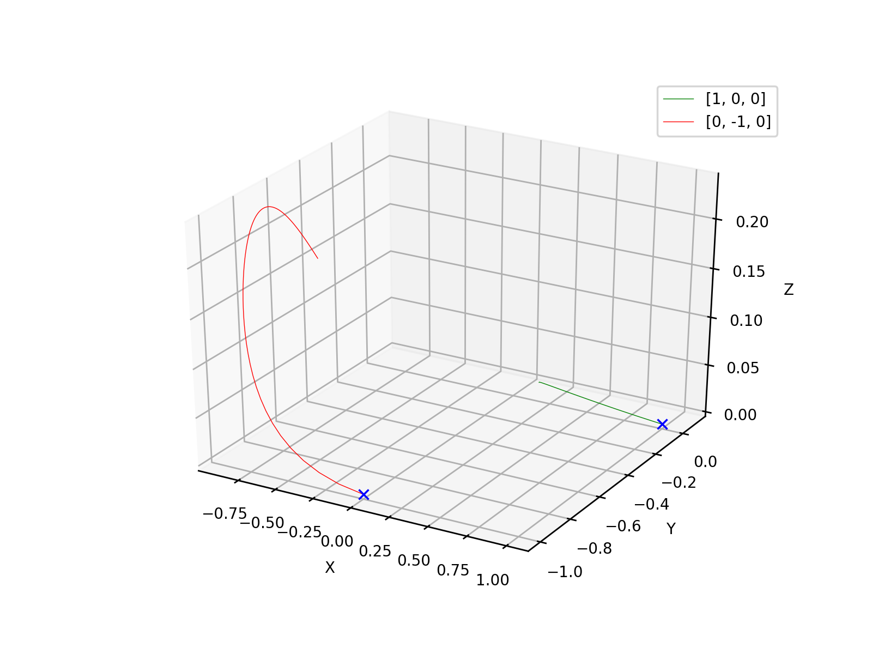
r = 1

Slide 4
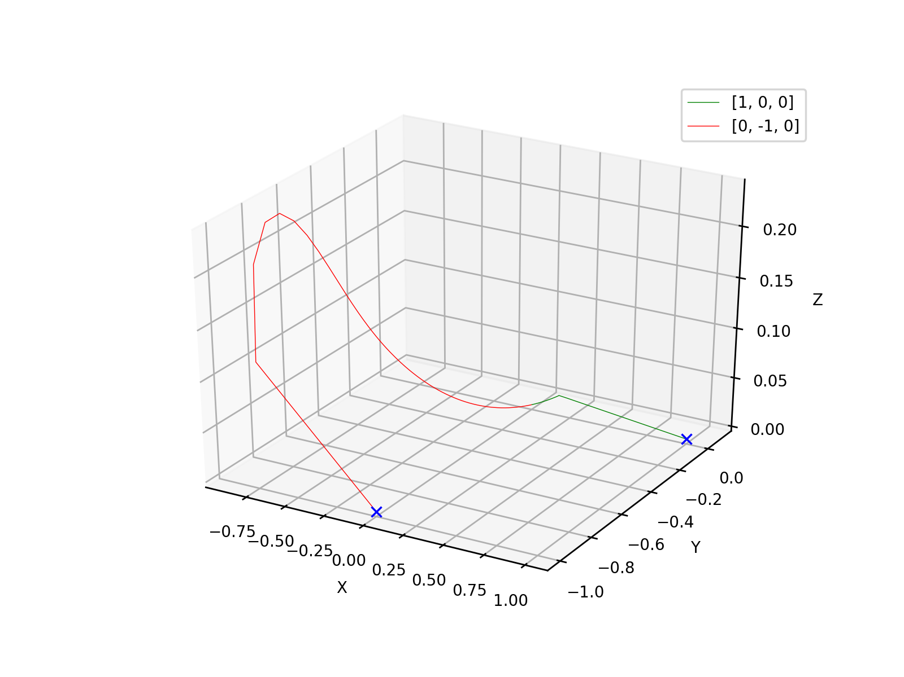
r = 1

Slide 5
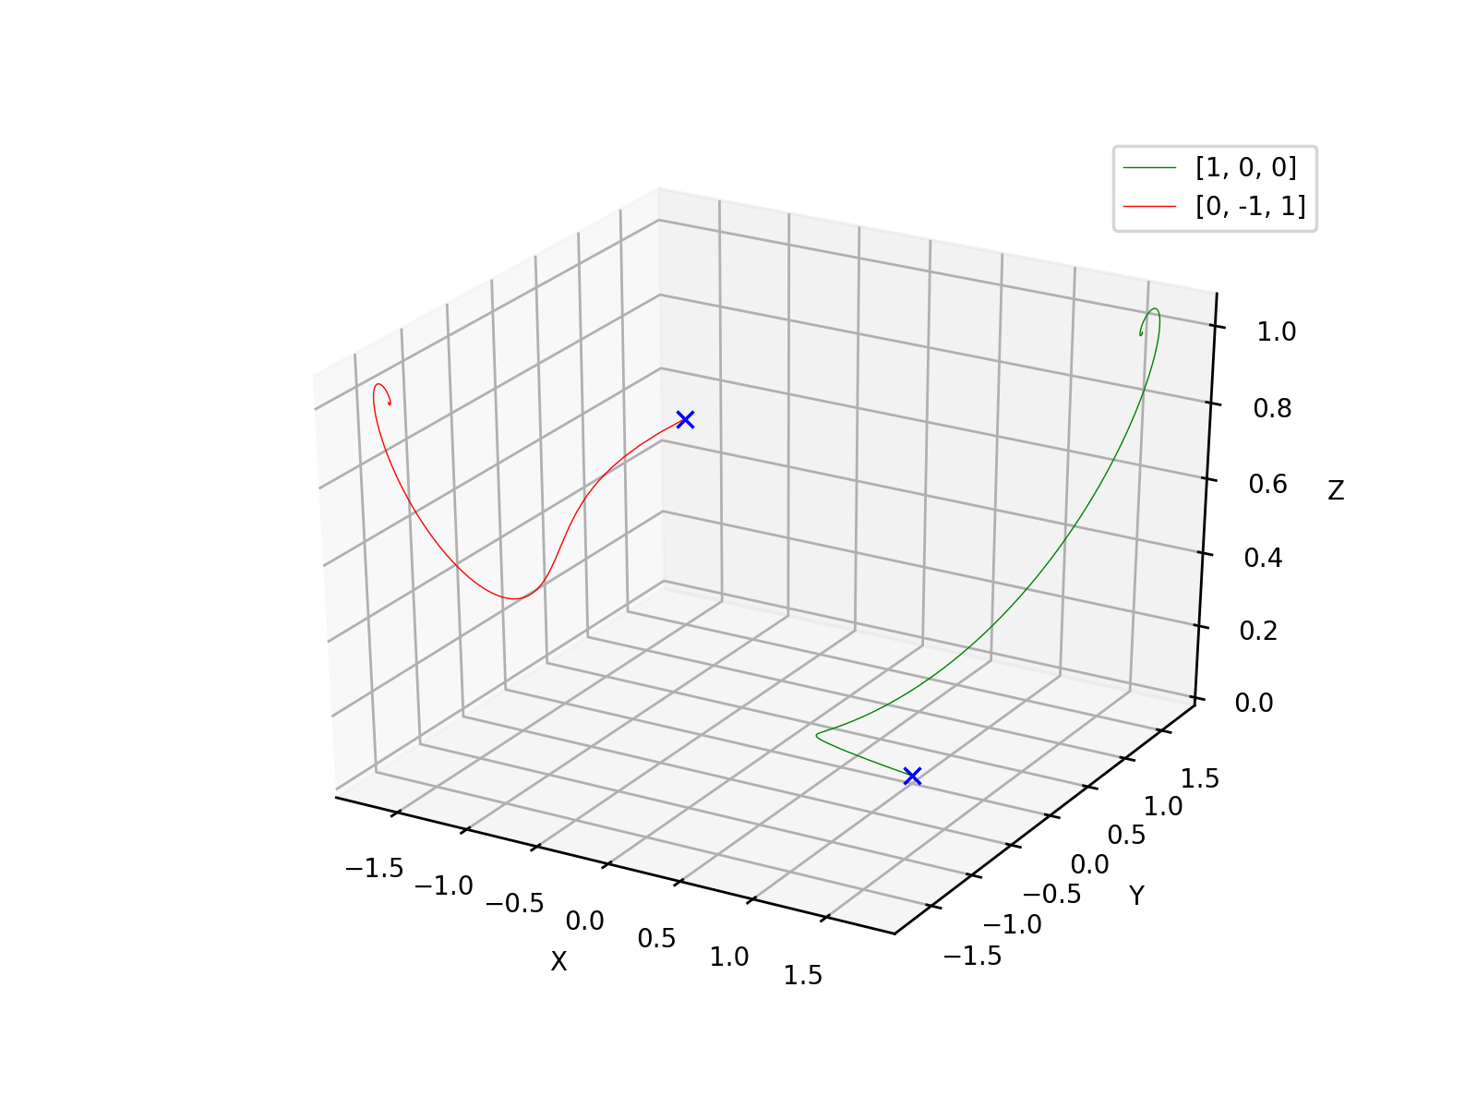
r = 2

Slide 6
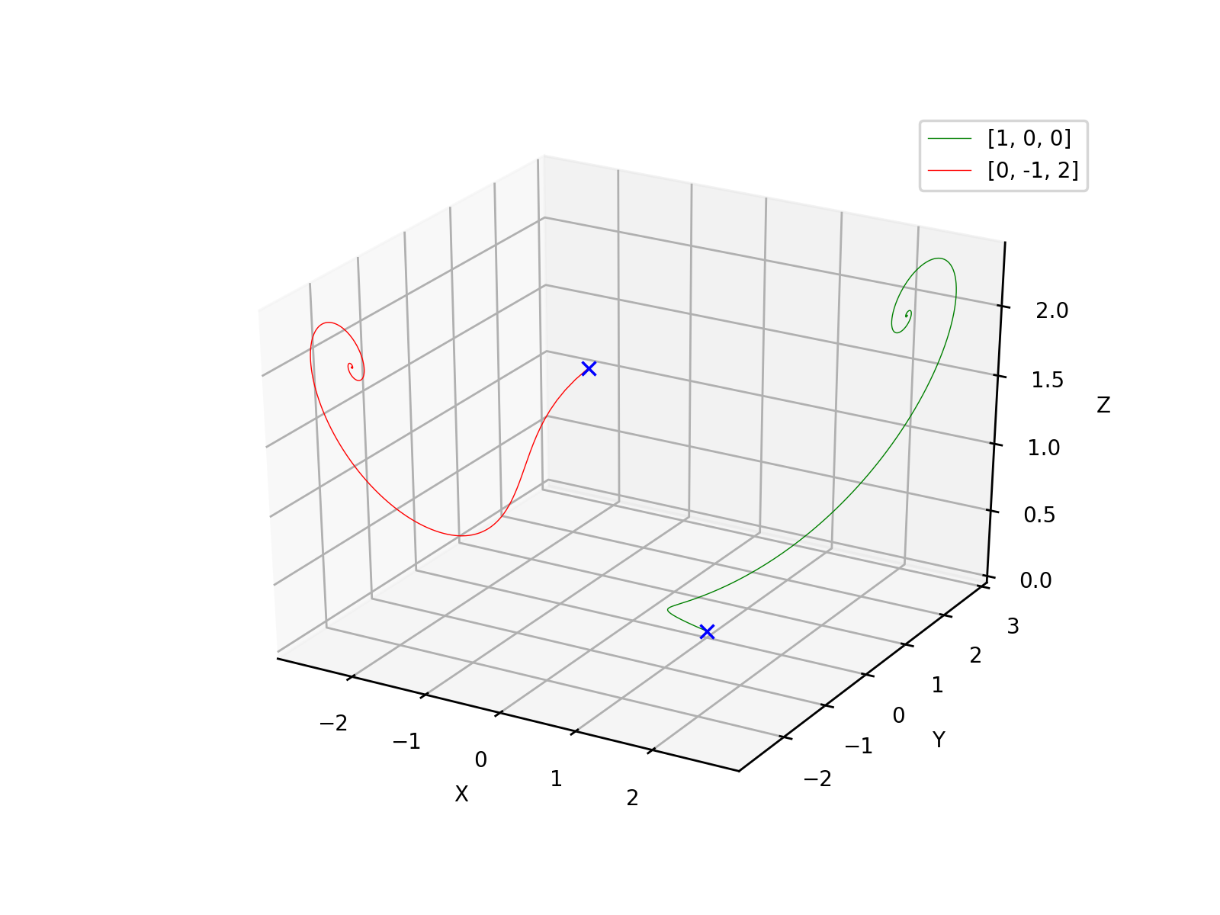
r = 3

Slide 7
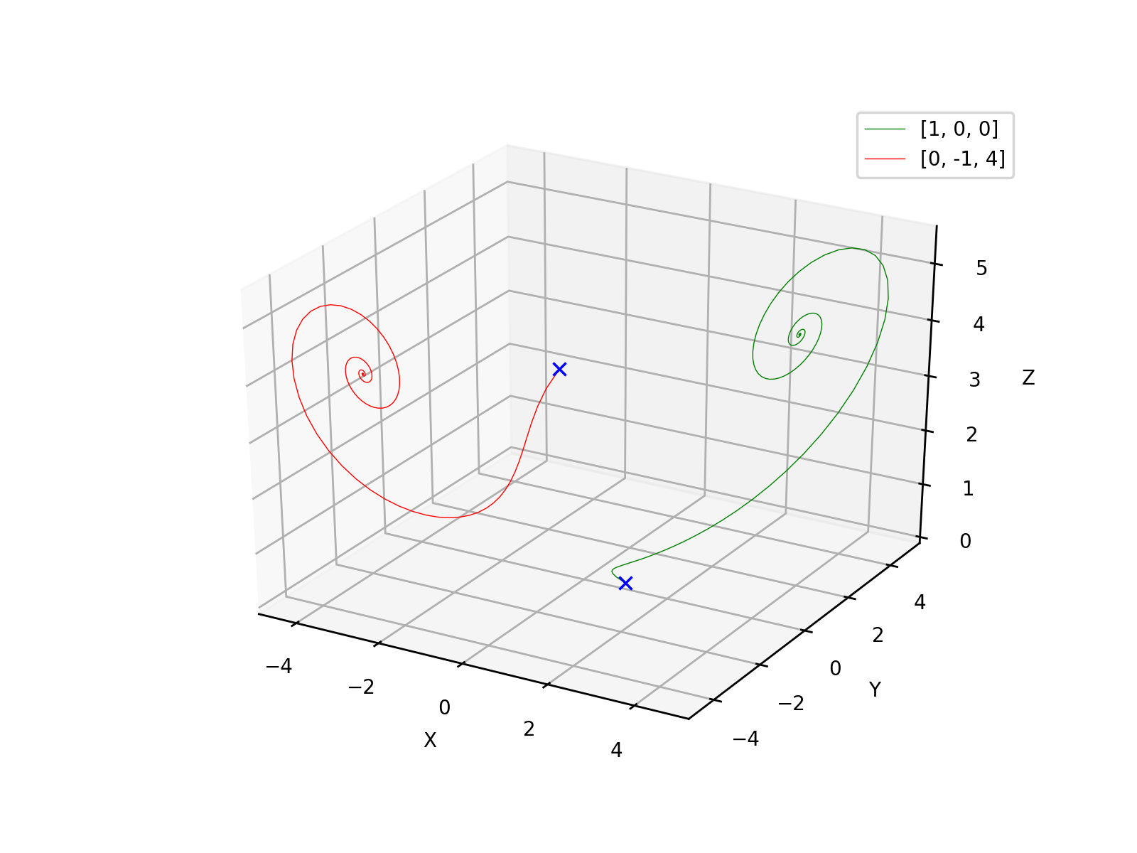
r = 5

Slide 8
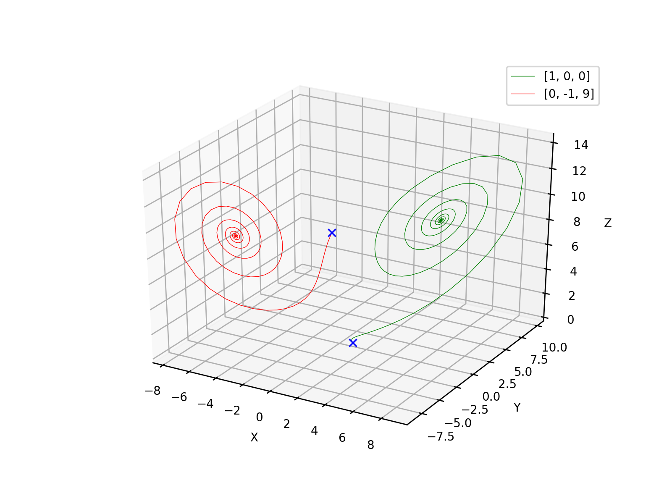
r = 10

Slide 9
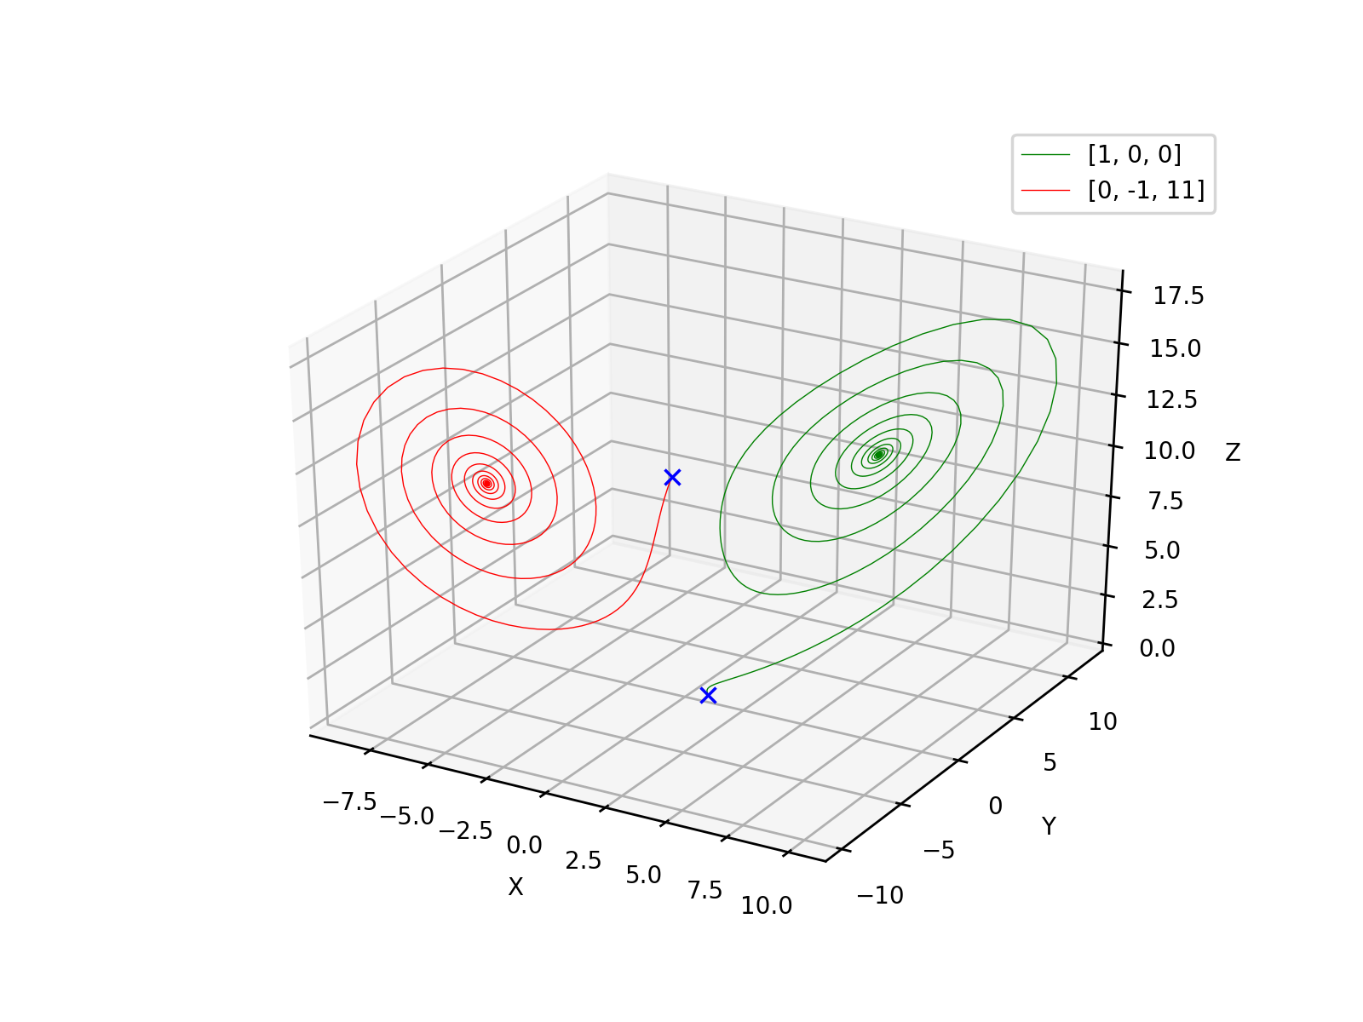
r = 12

Slide 10
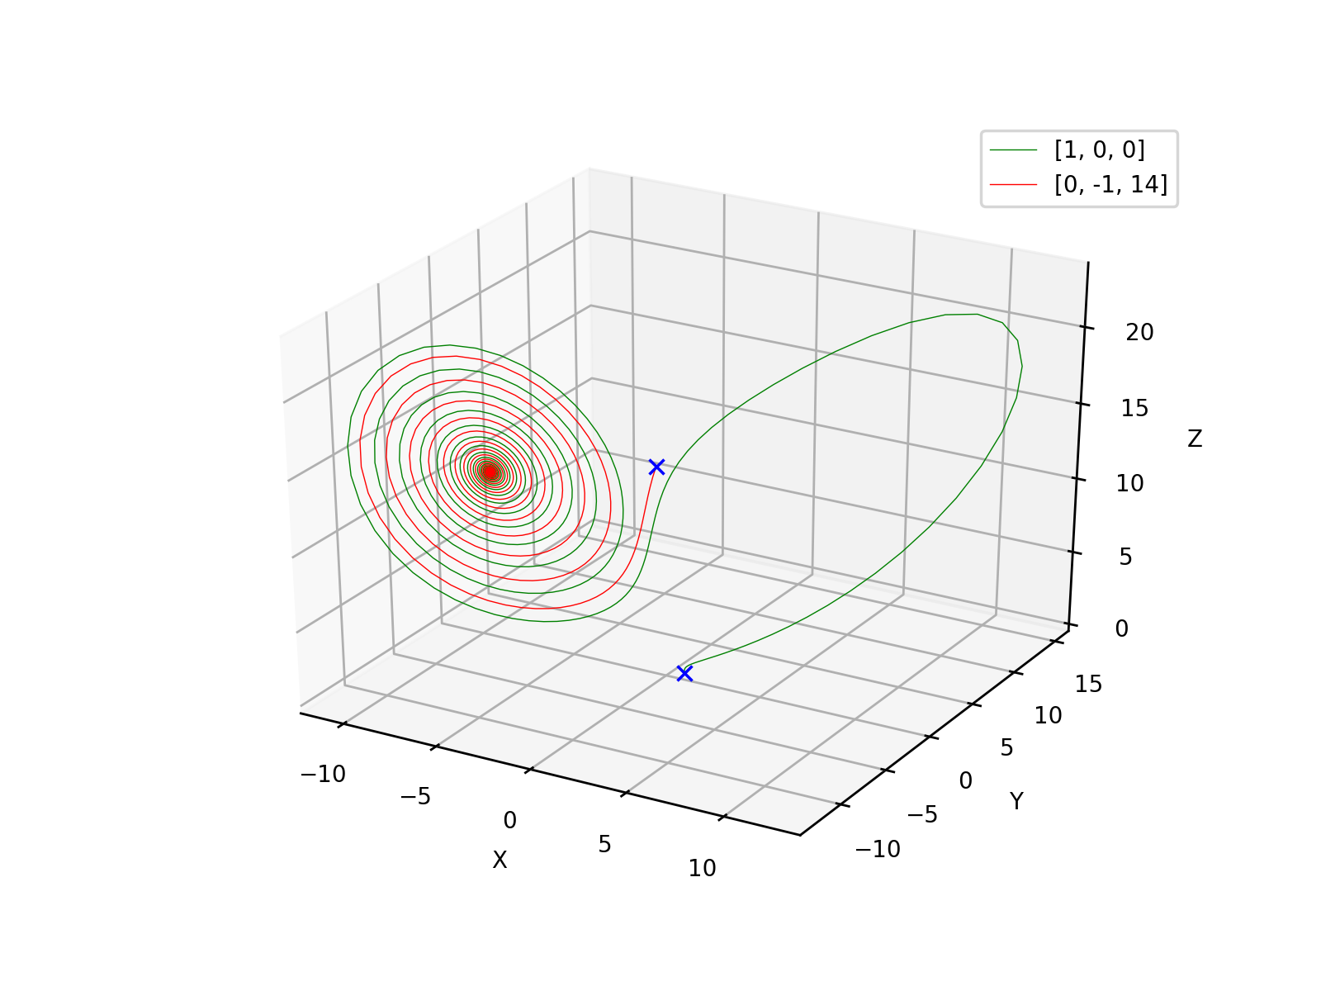
r = 15

Slide 11
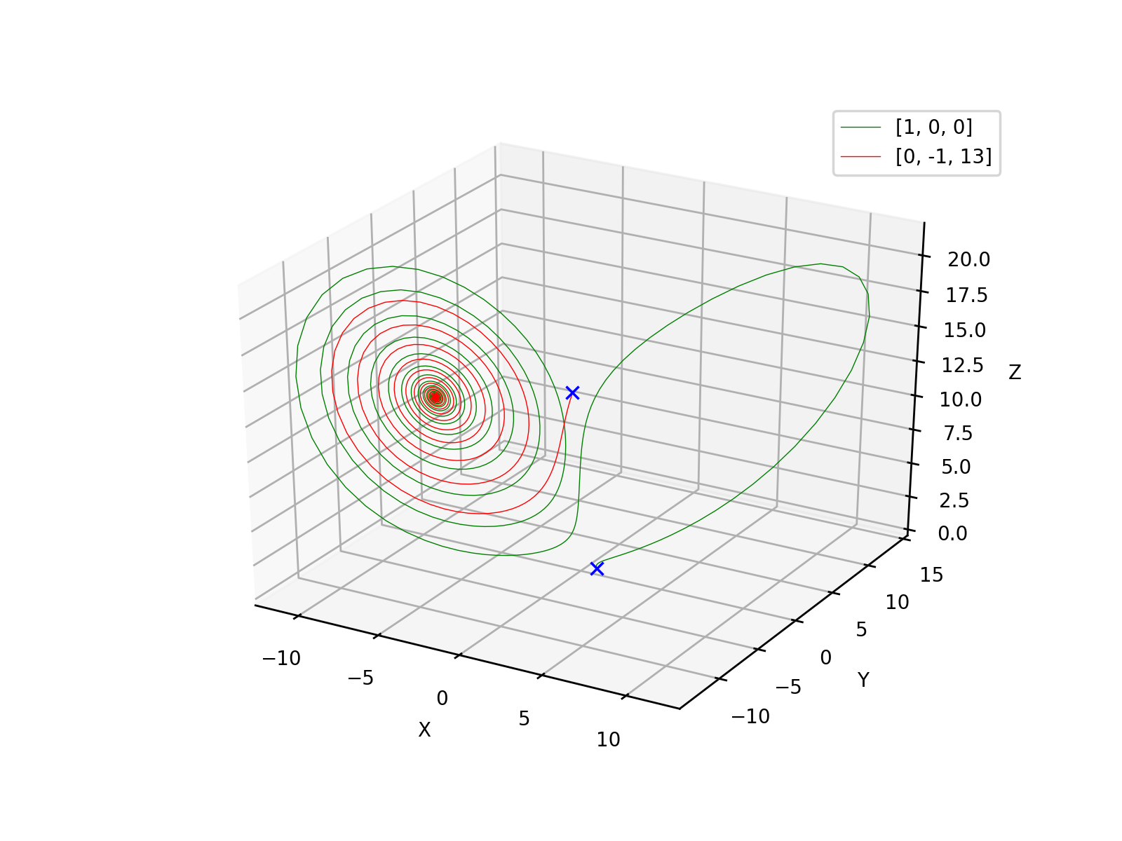
r = 14

Slide 12
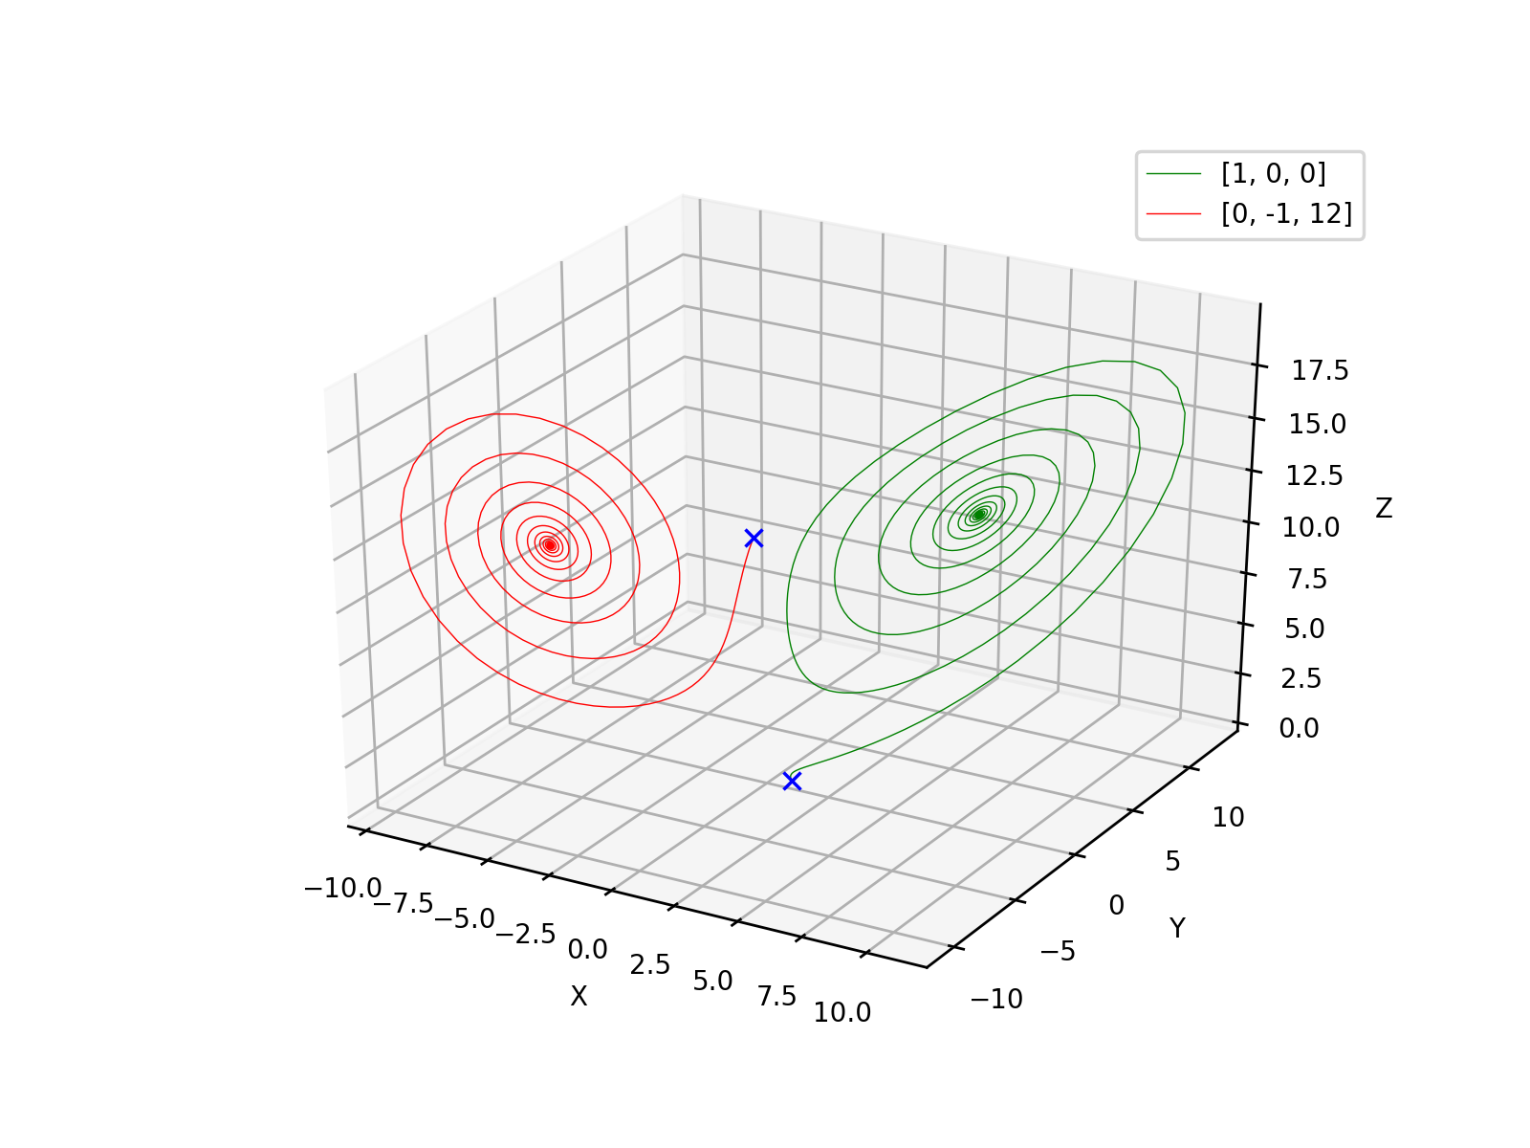
r = 13

Slide 13
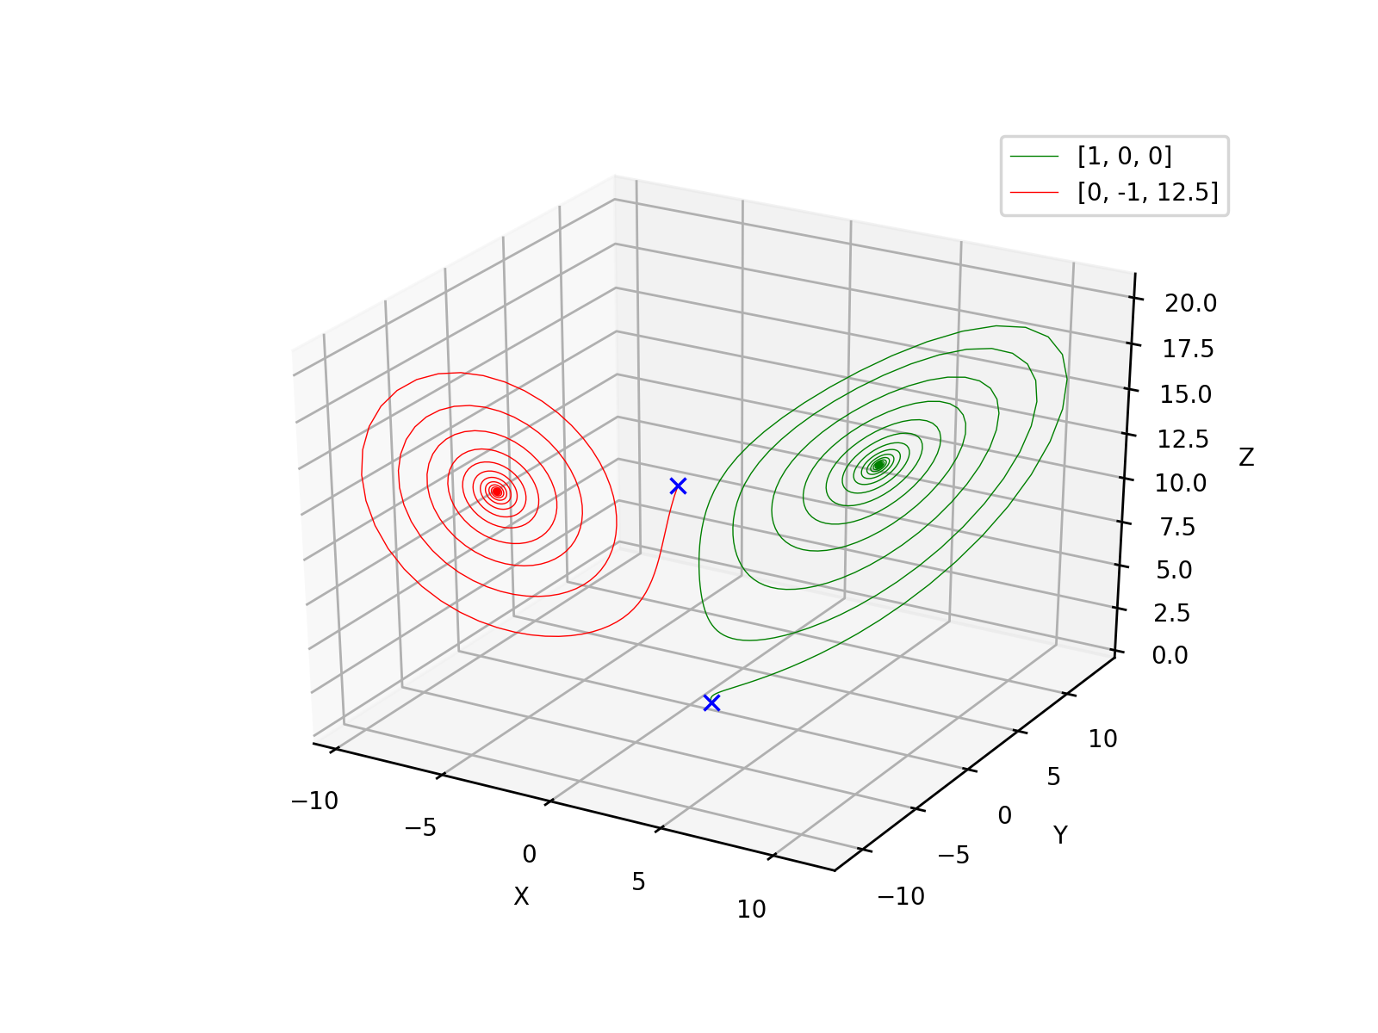
r = 13.5

Slide 14
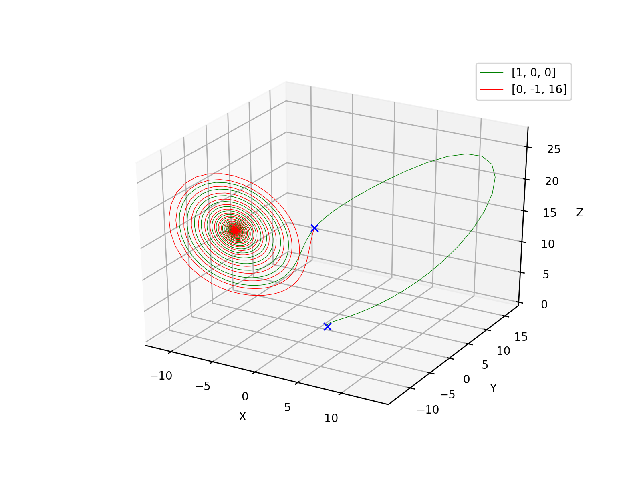
r = 17

Slide 15
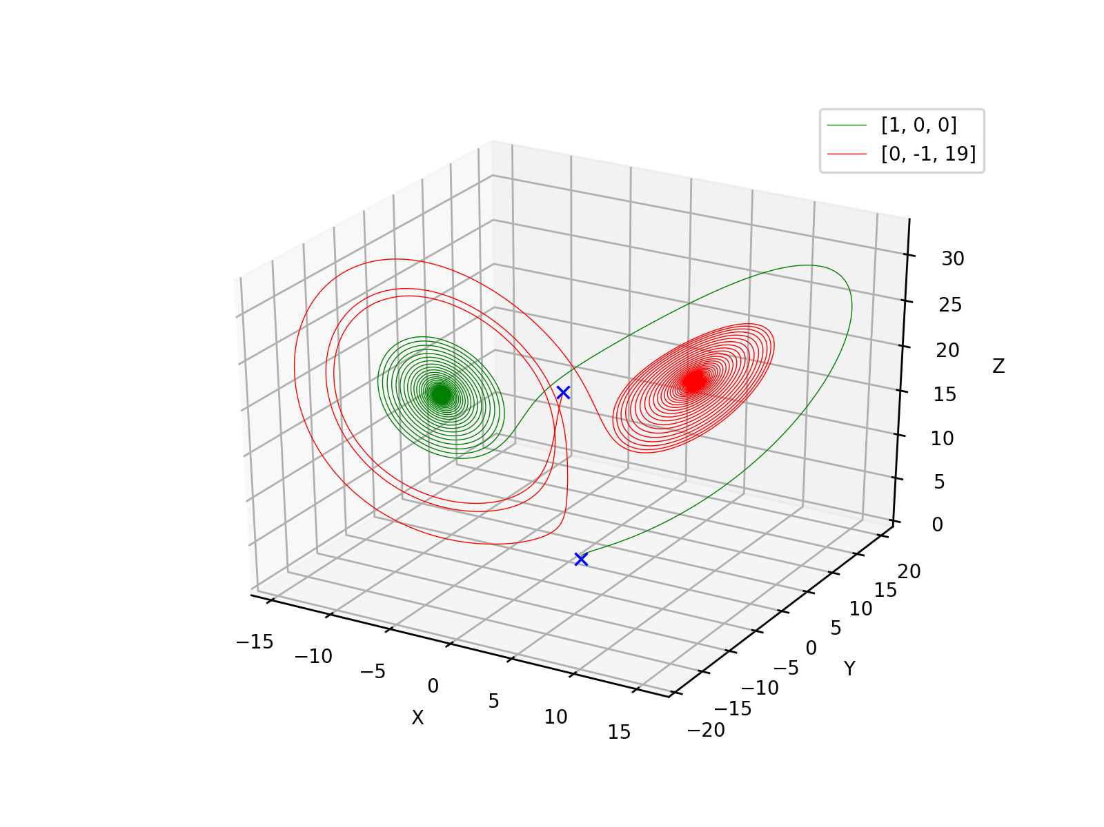
r = 20

Slide 16
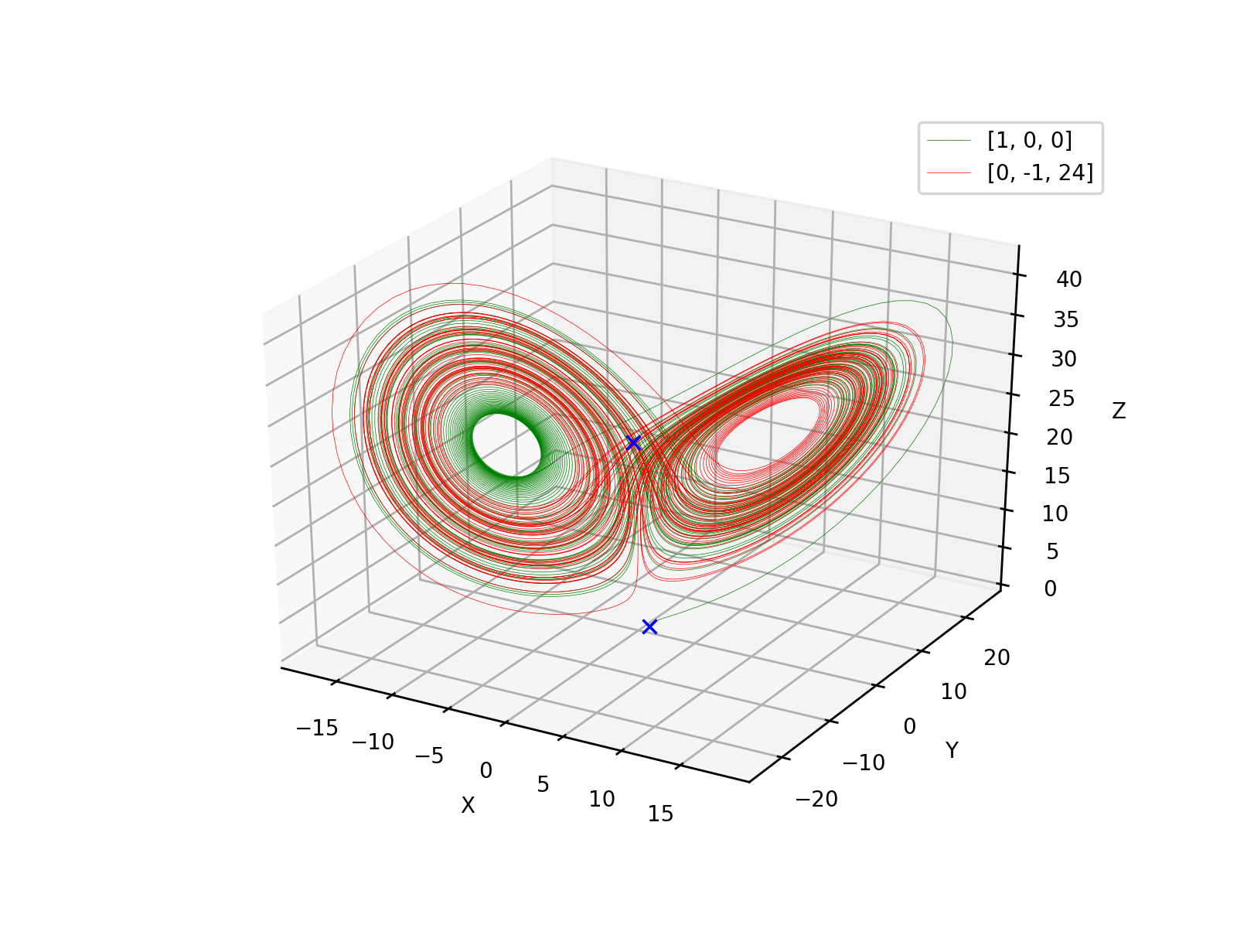
r = 25

Slide 17
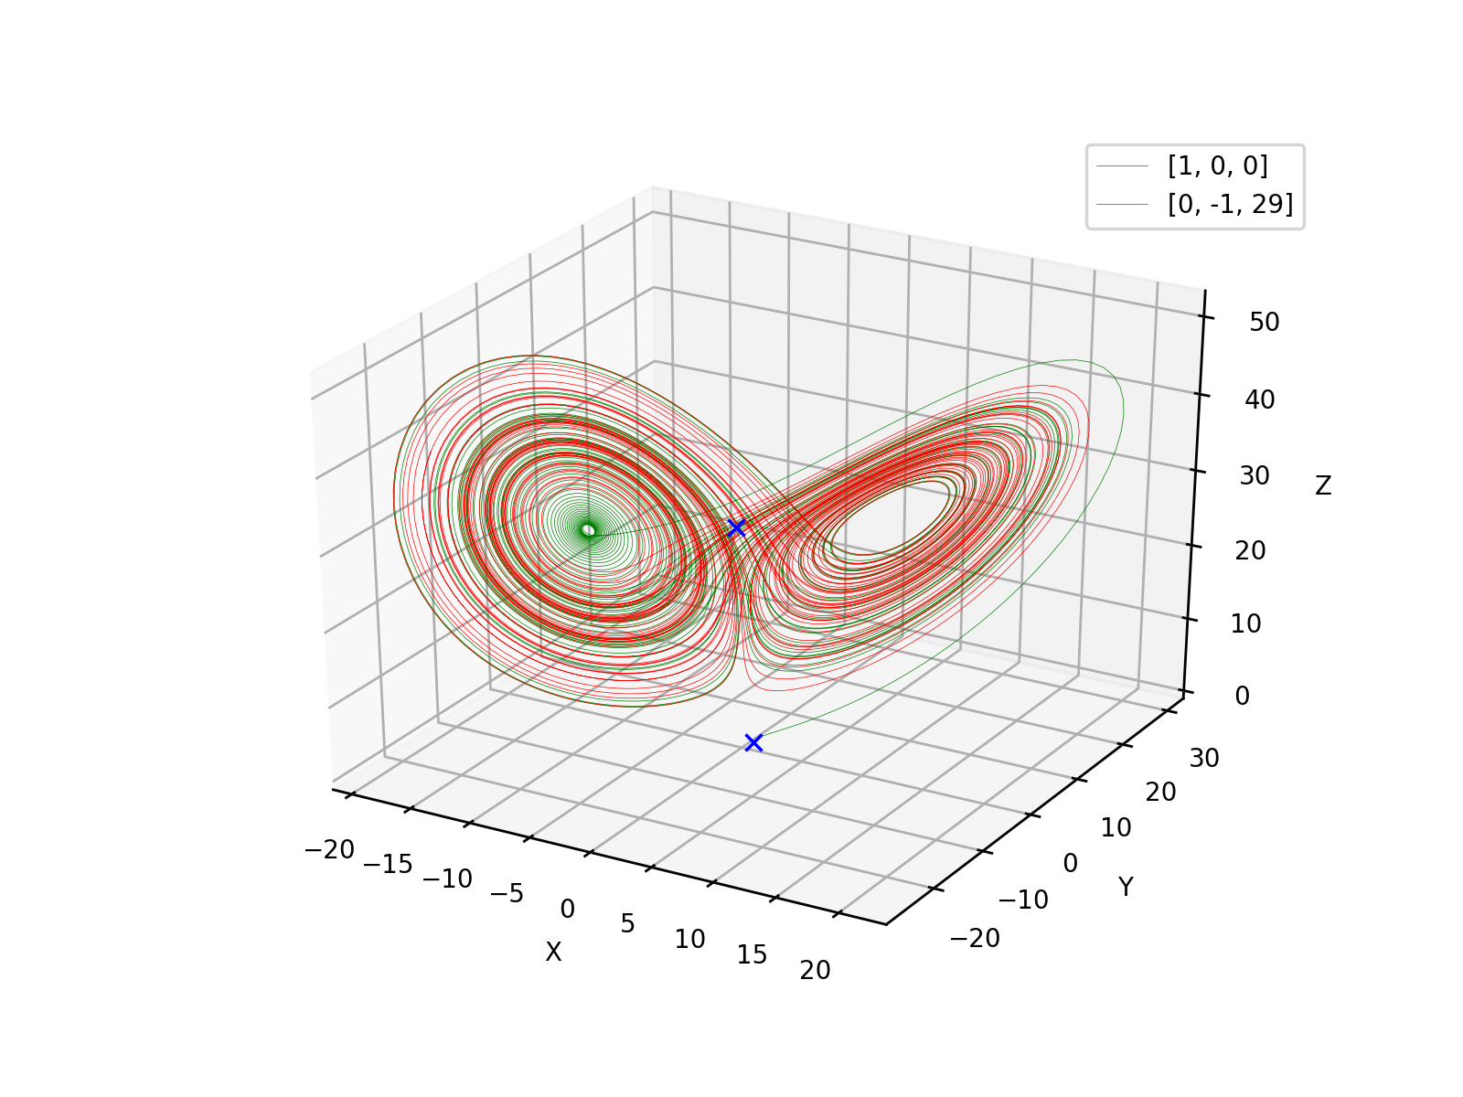
r = 30

Slide 18
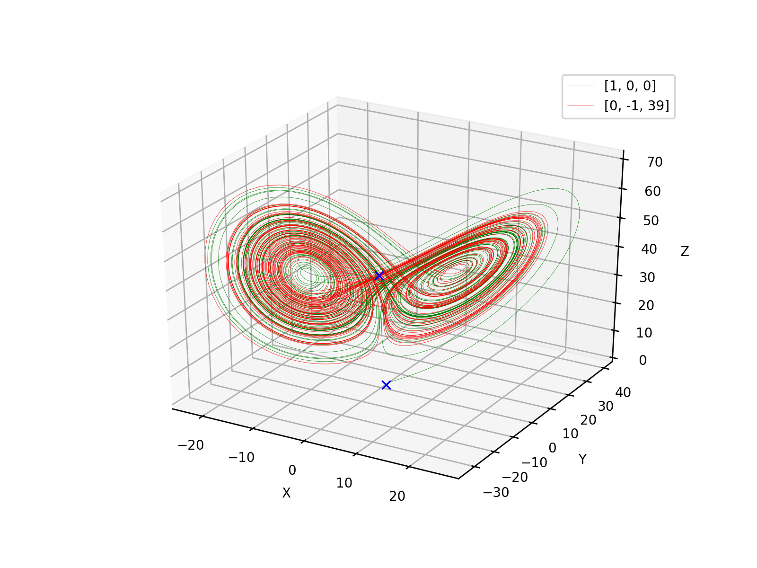
r = 40

Slide 19
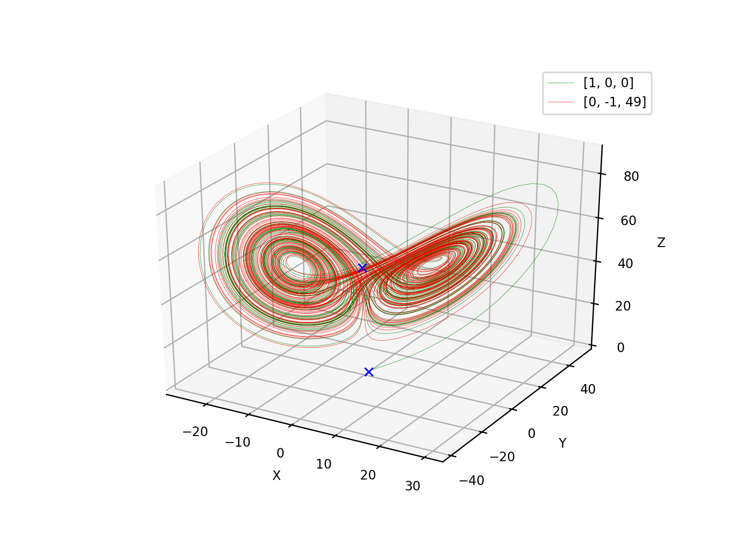
r = 50

Slide 20
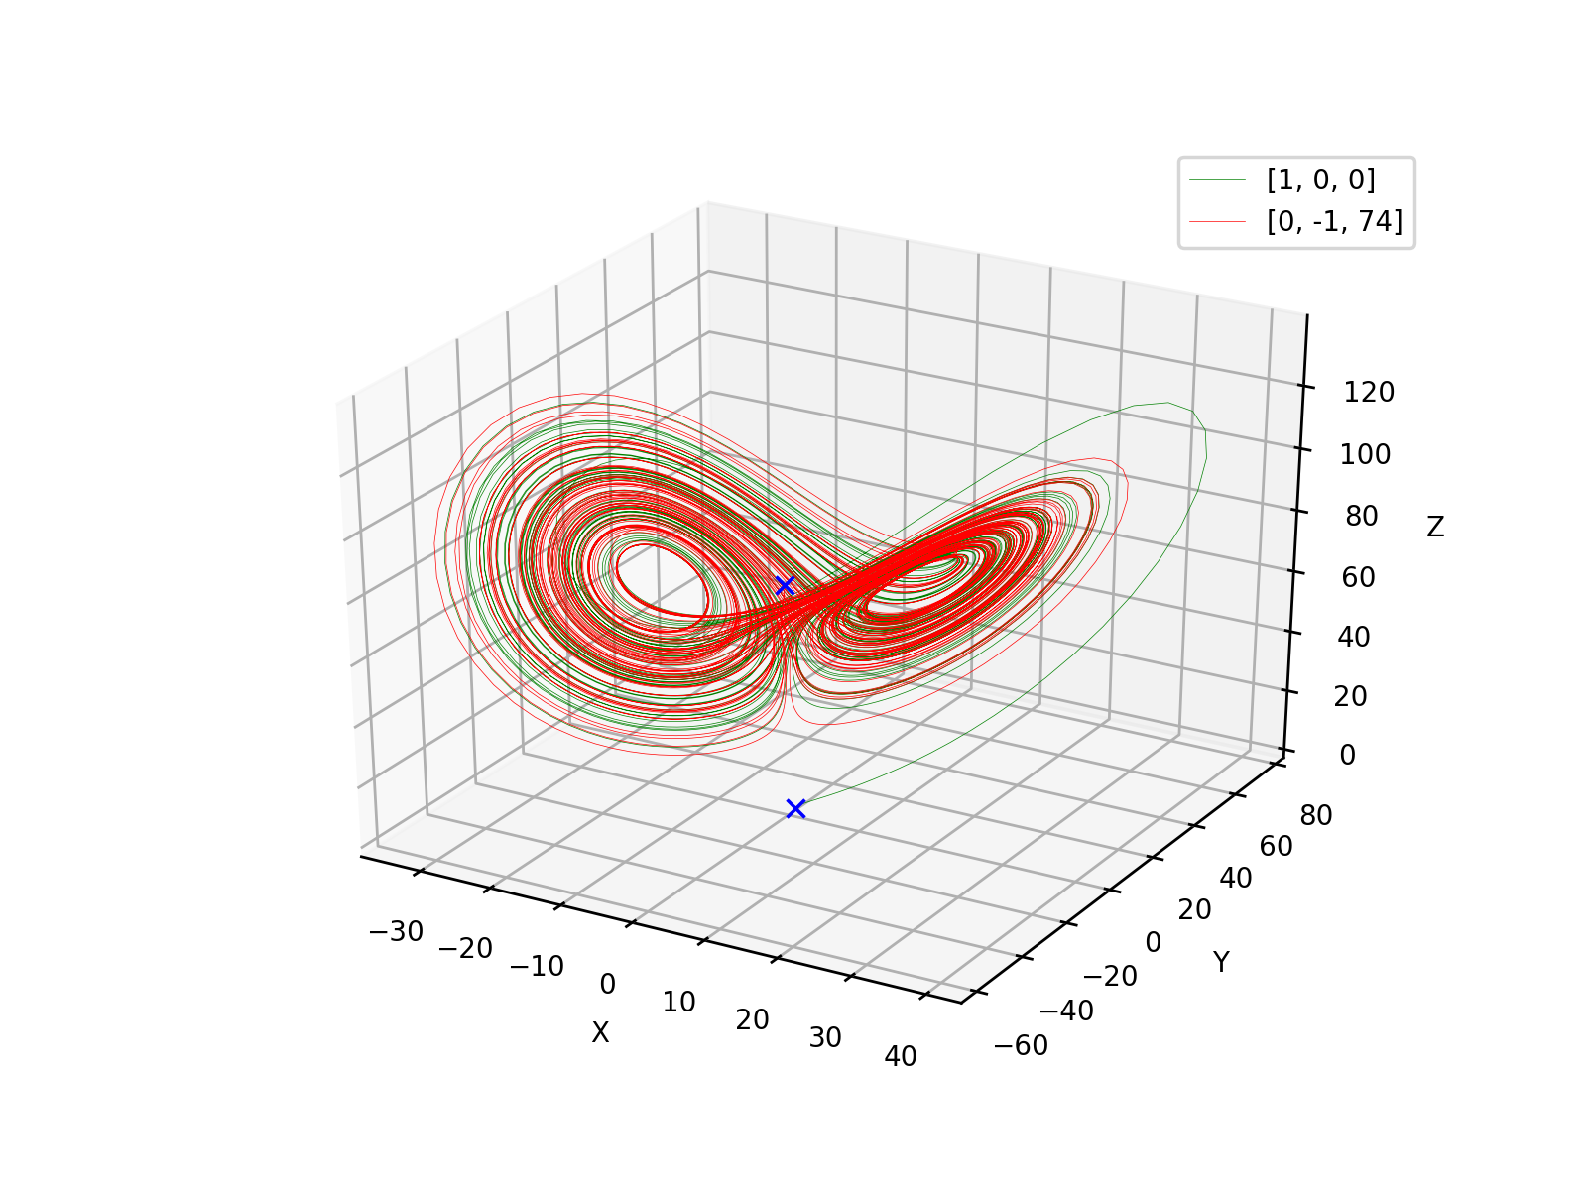
r = 75

Slide 21
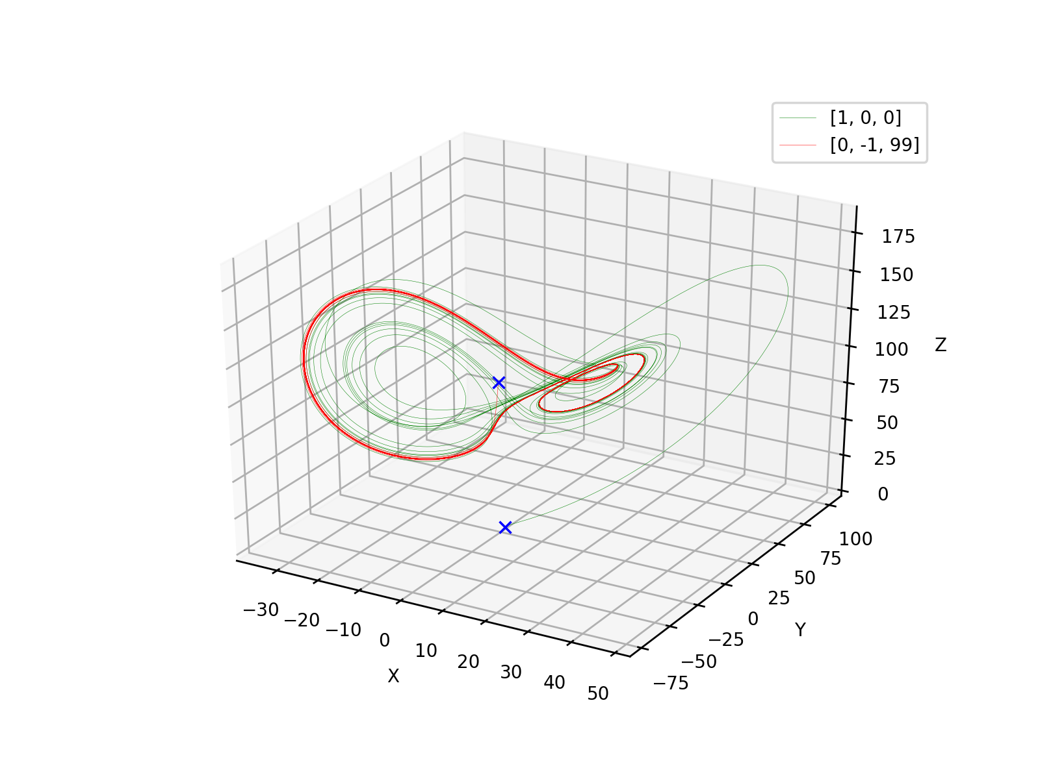
r = 100

Slide 22
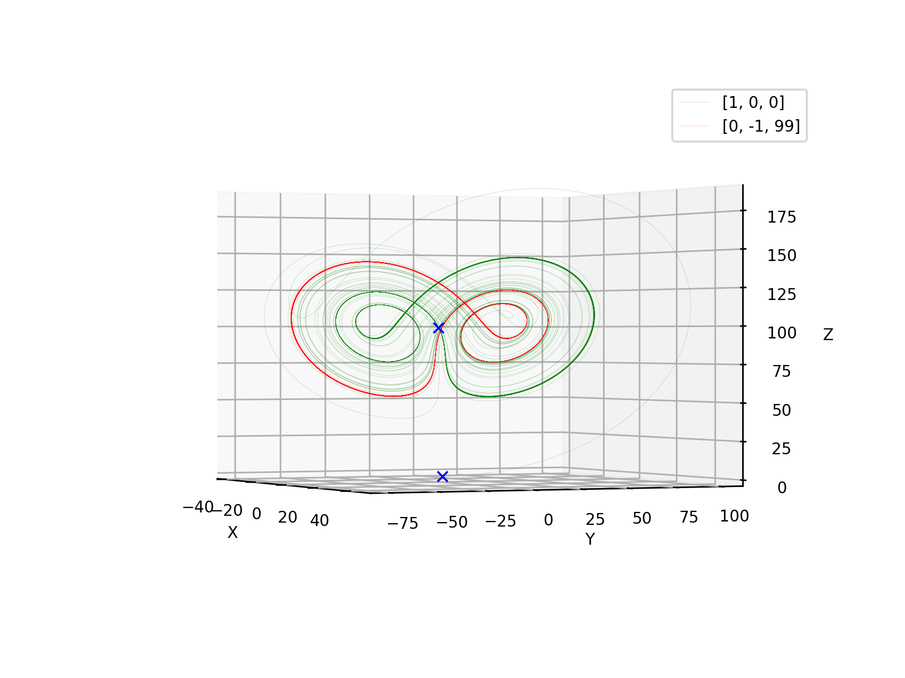
r = 100 #ax.view_init(0,-25)

Slide 23
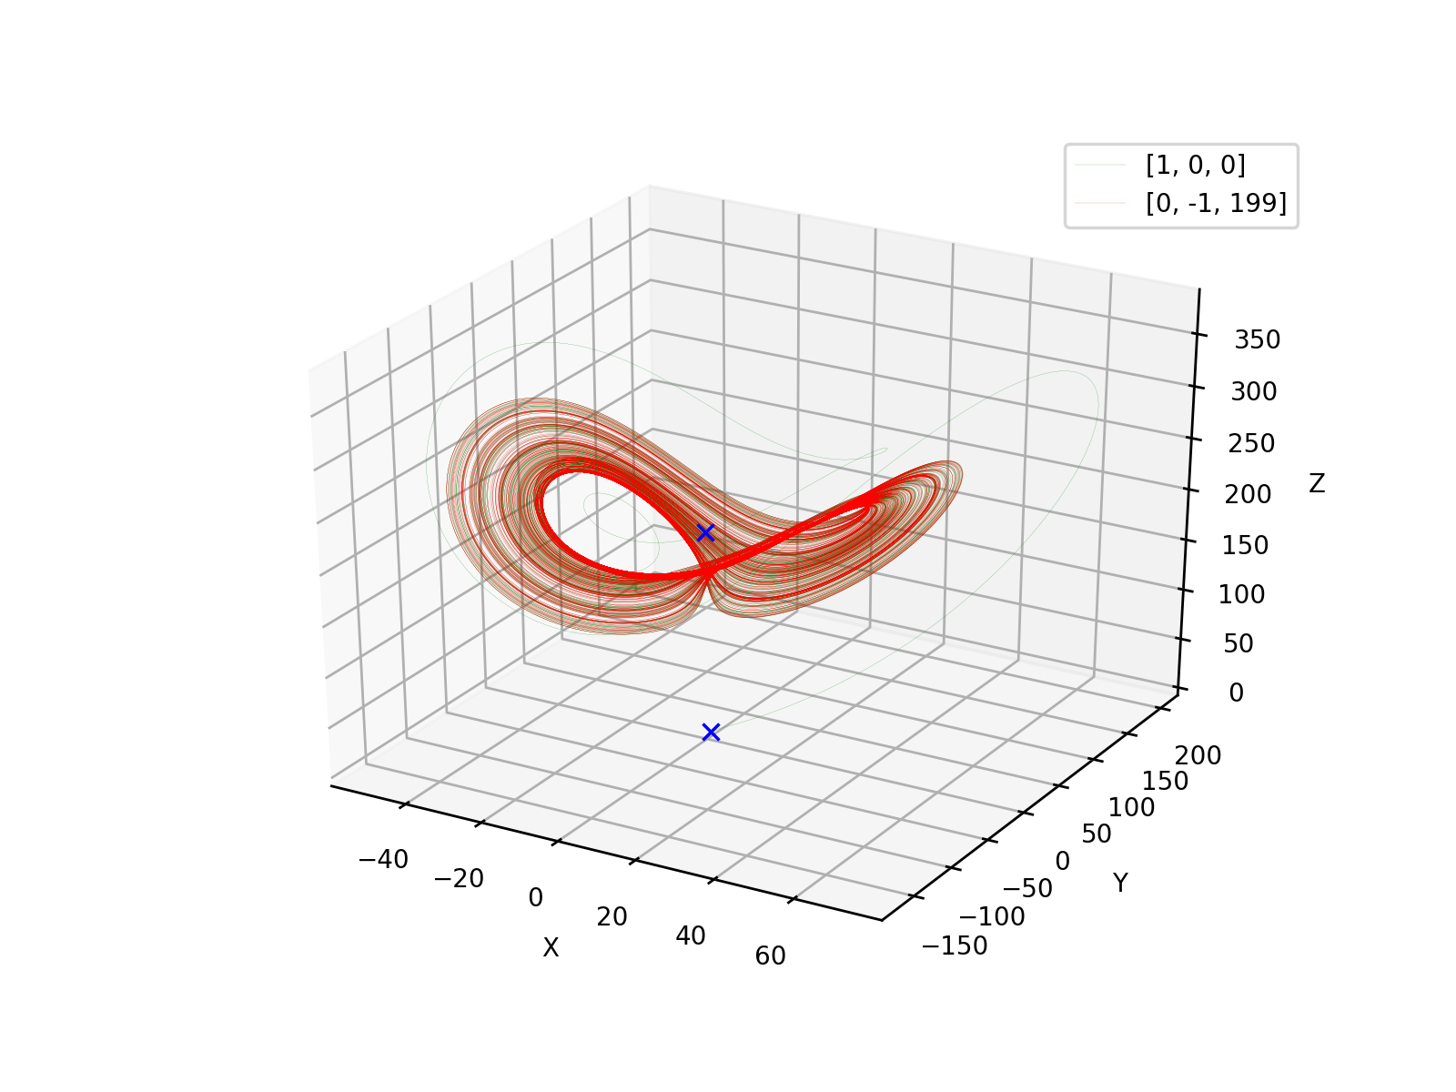
r = 200

Slide 24
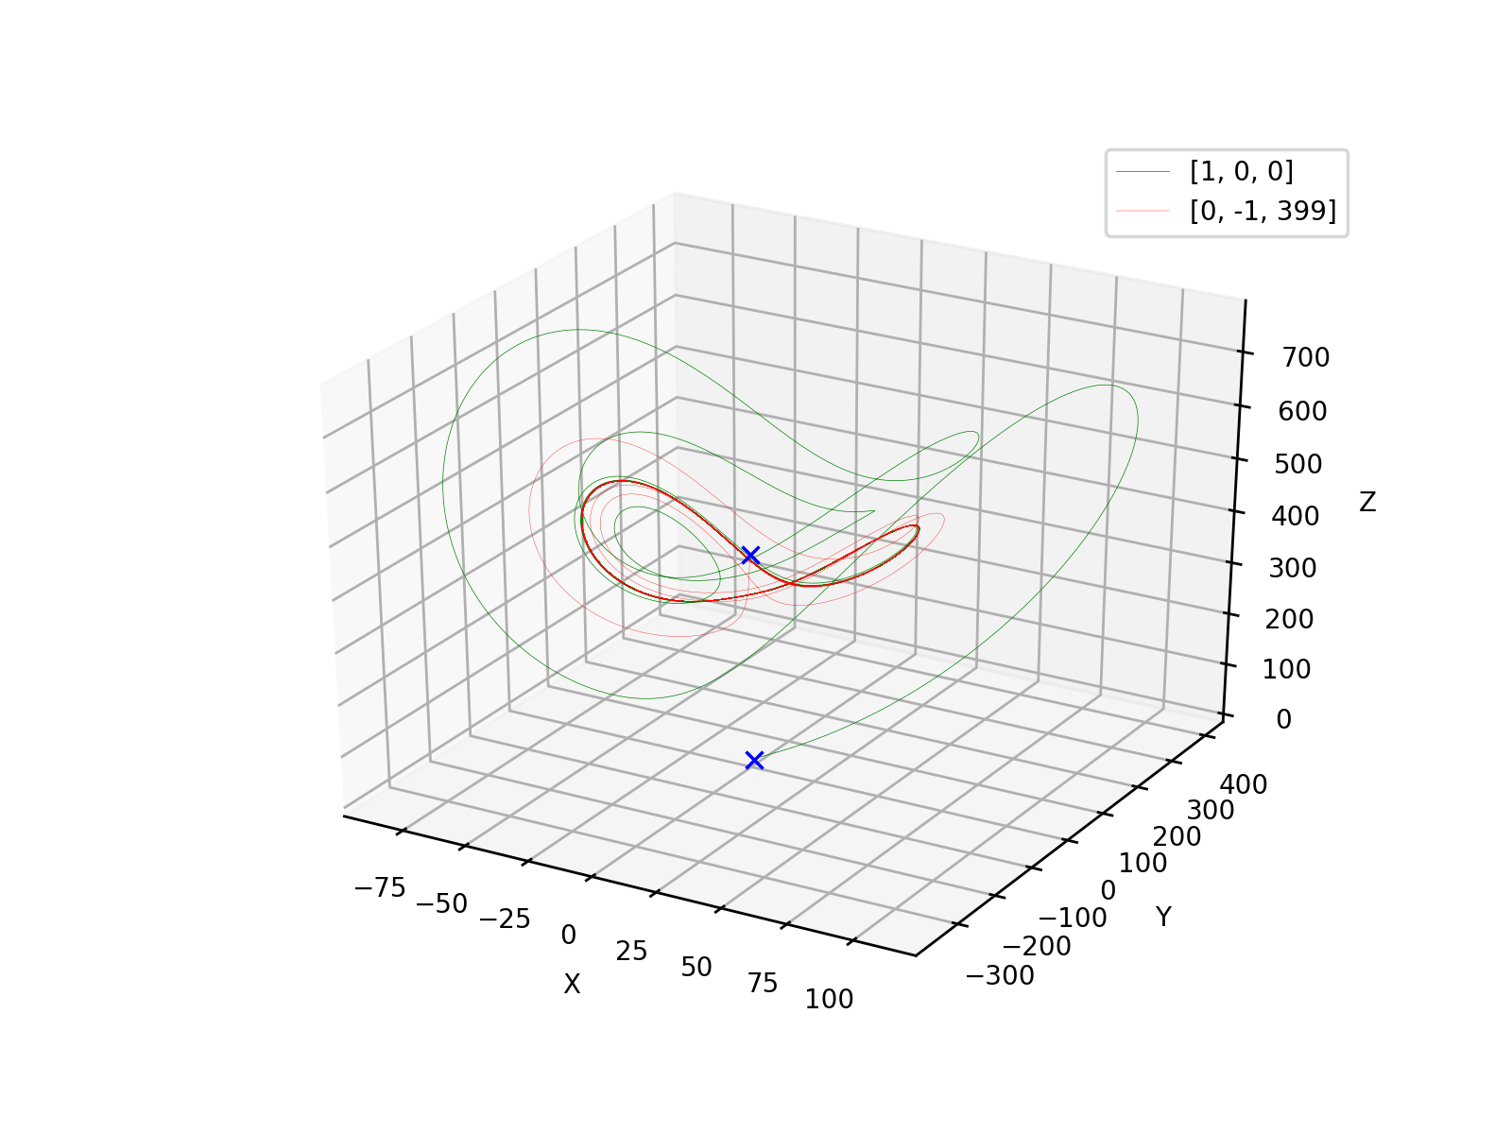
r = 400

Slide 25
r = 1

Slide 26
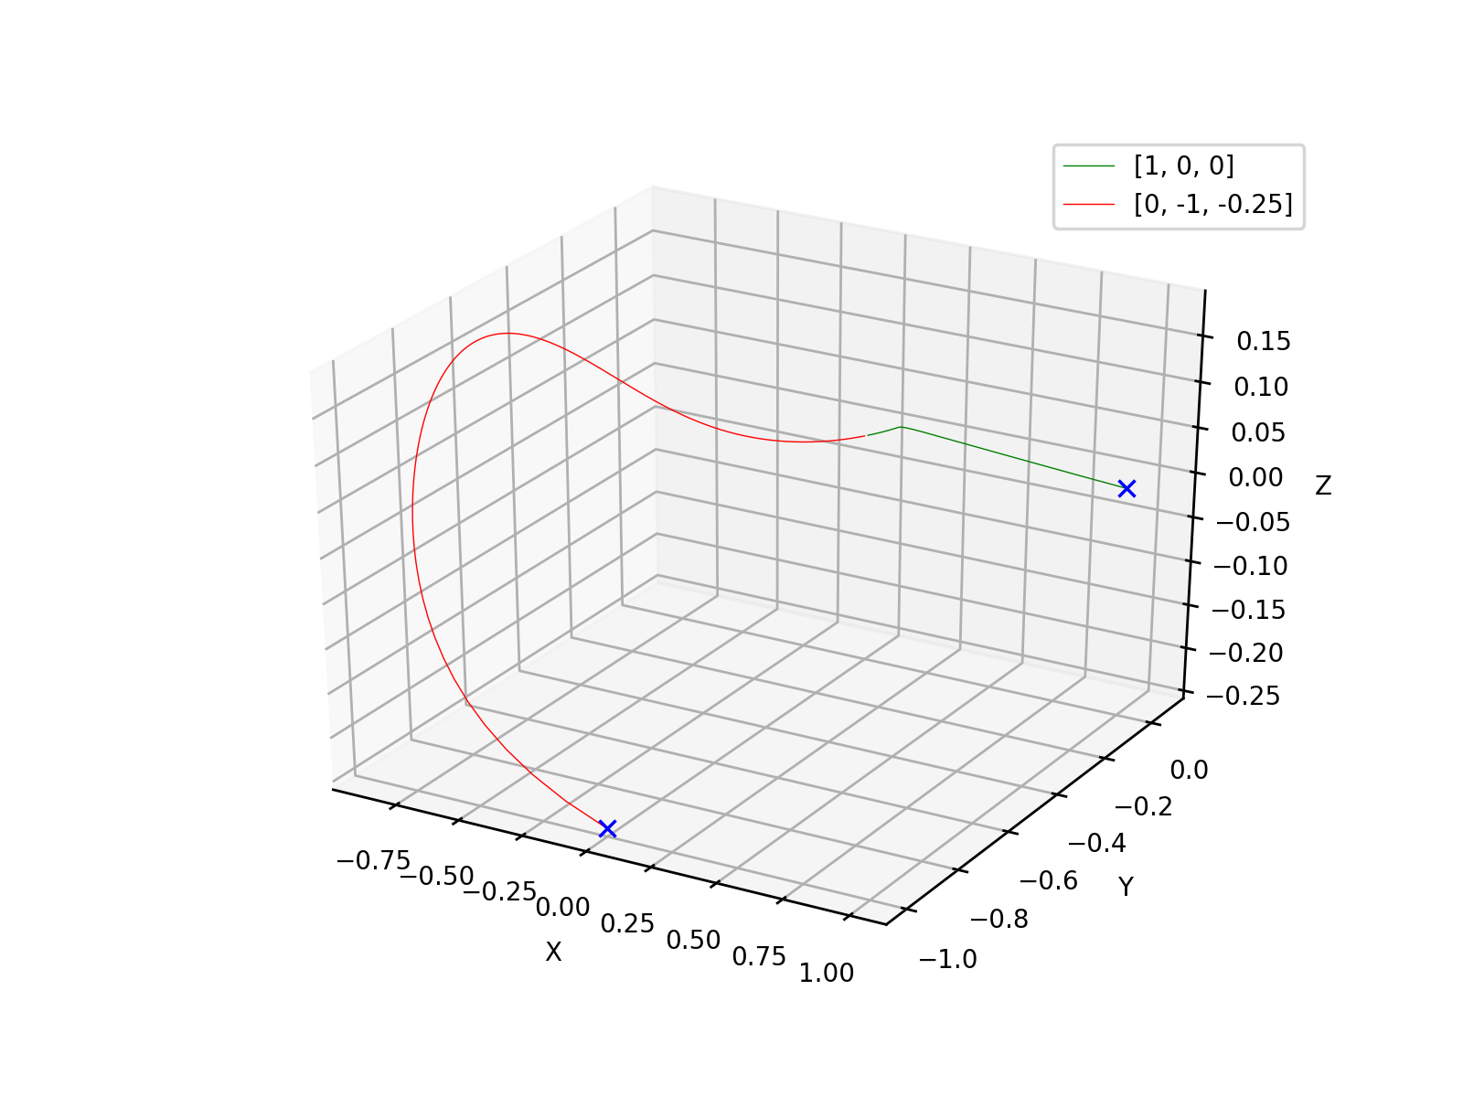
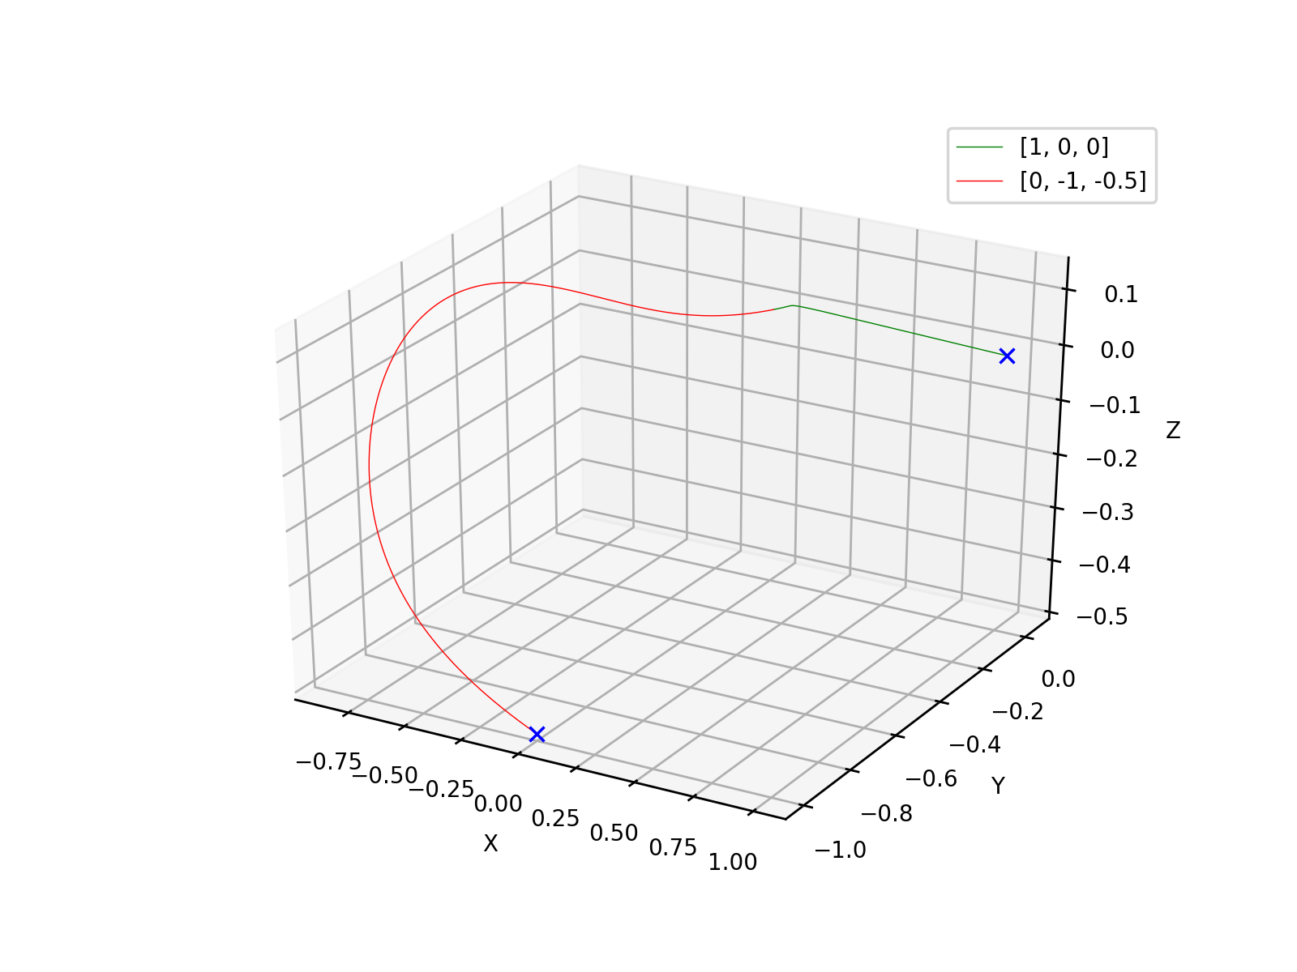
r = 0.75
r = 0.5

Slide 27
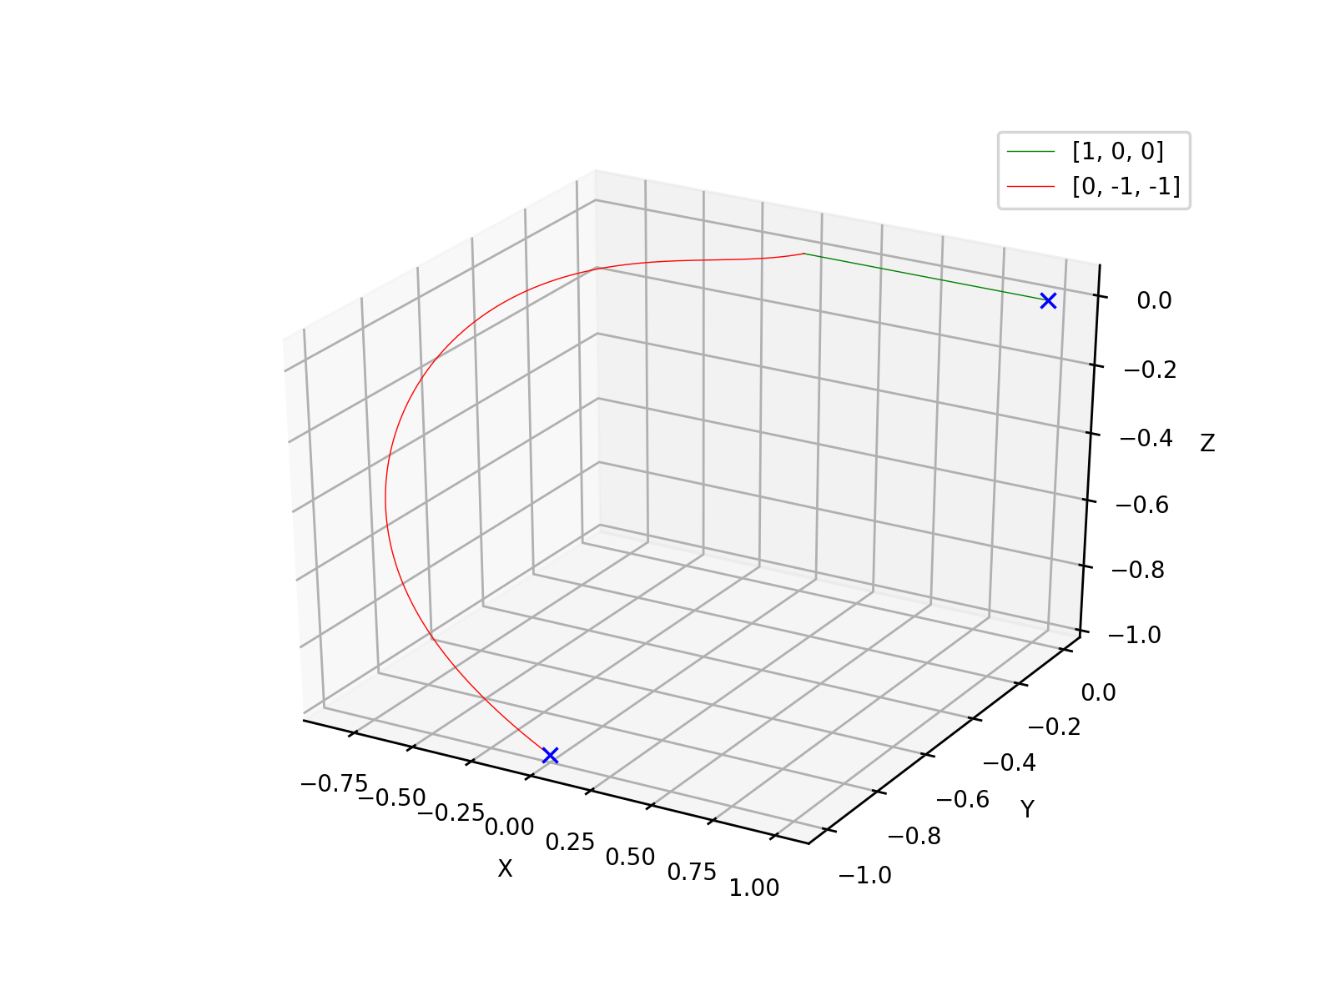
r = 0

Slide 28
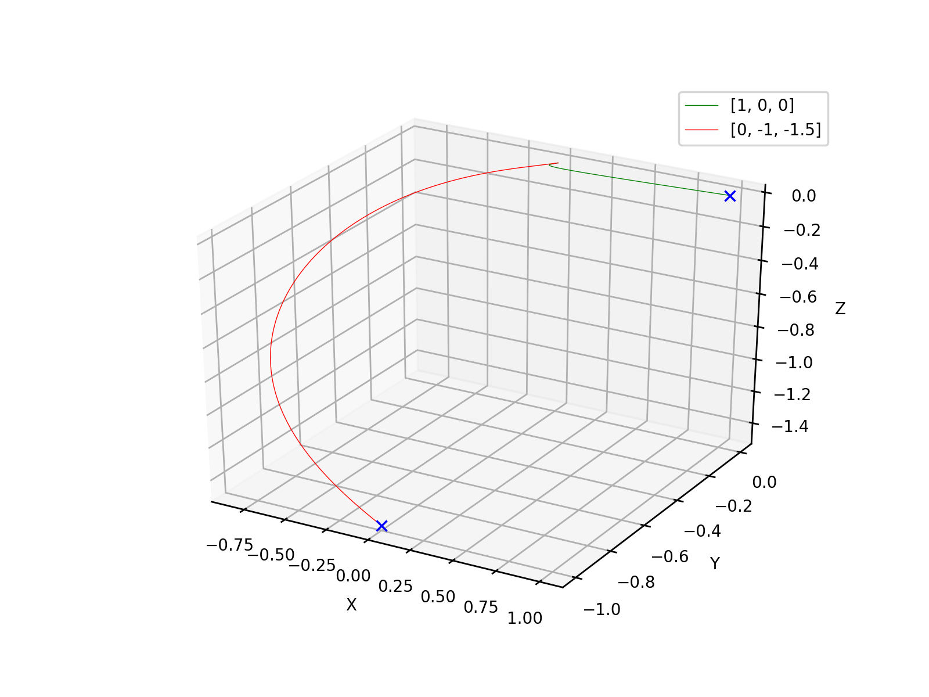
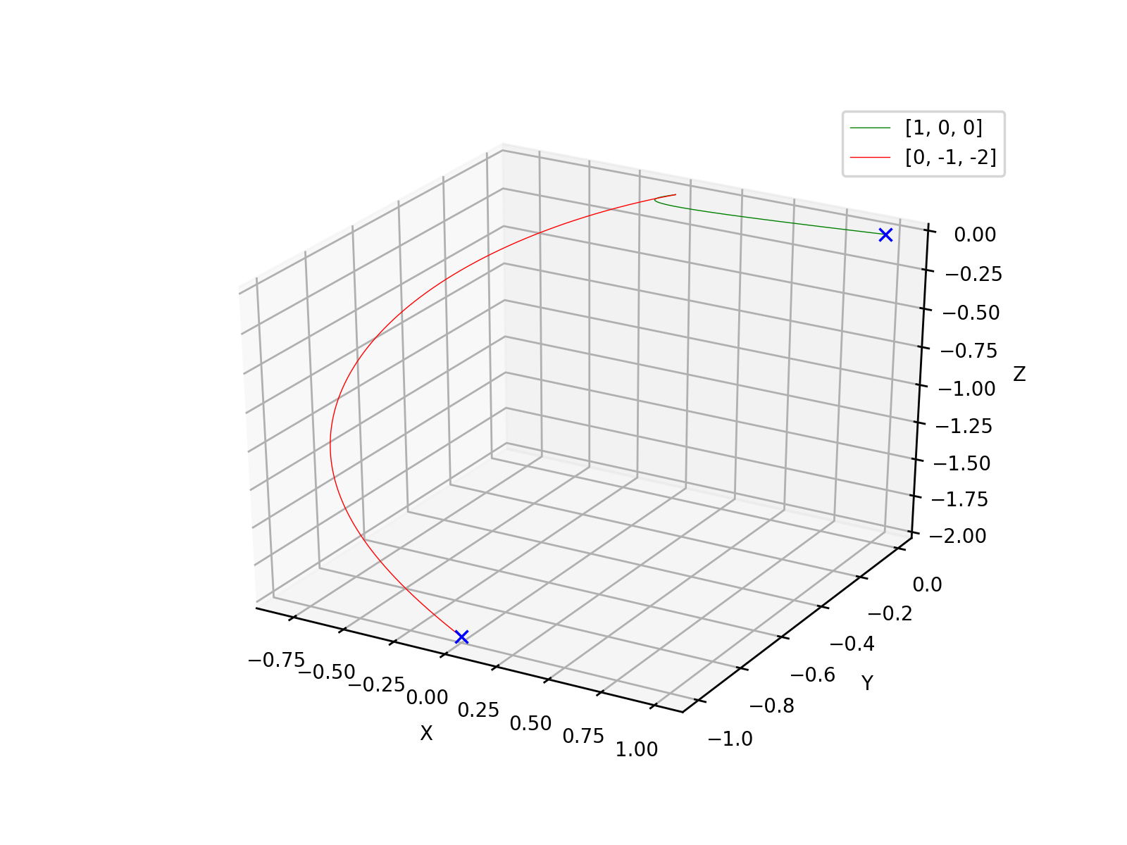
r = -0.5
r = -1

Slide 29
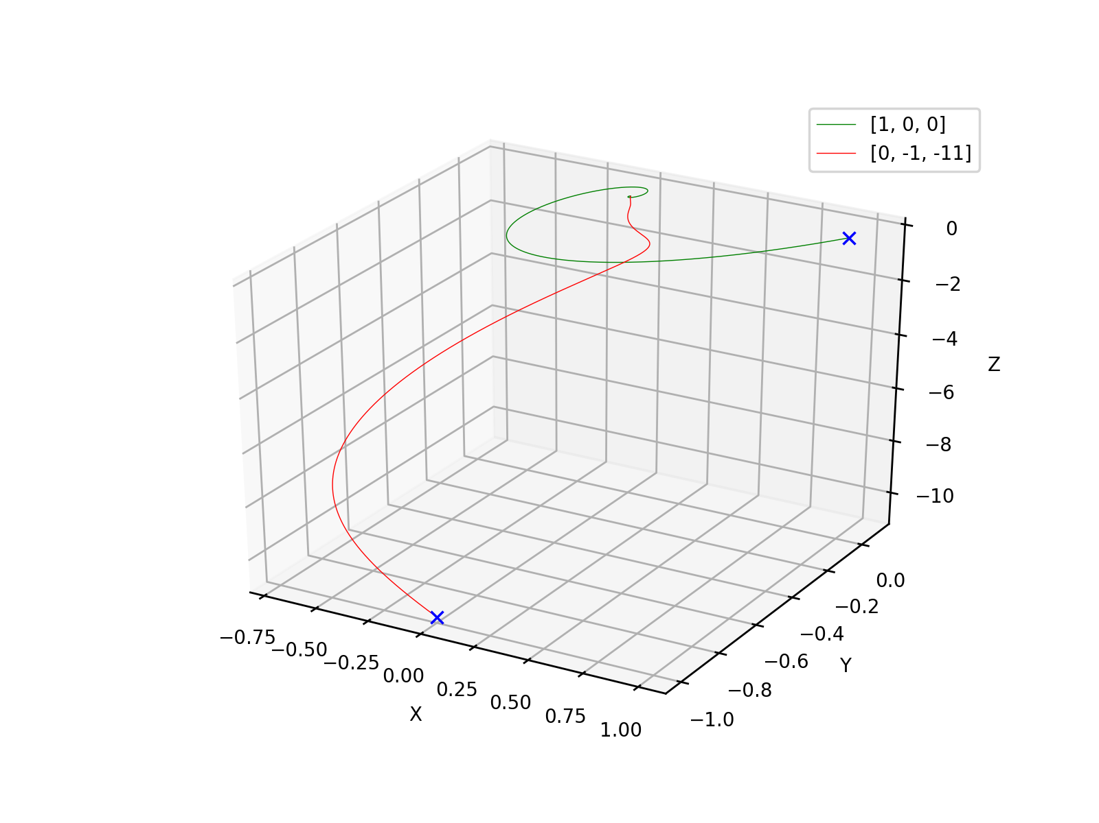
r = -10

Slide 30
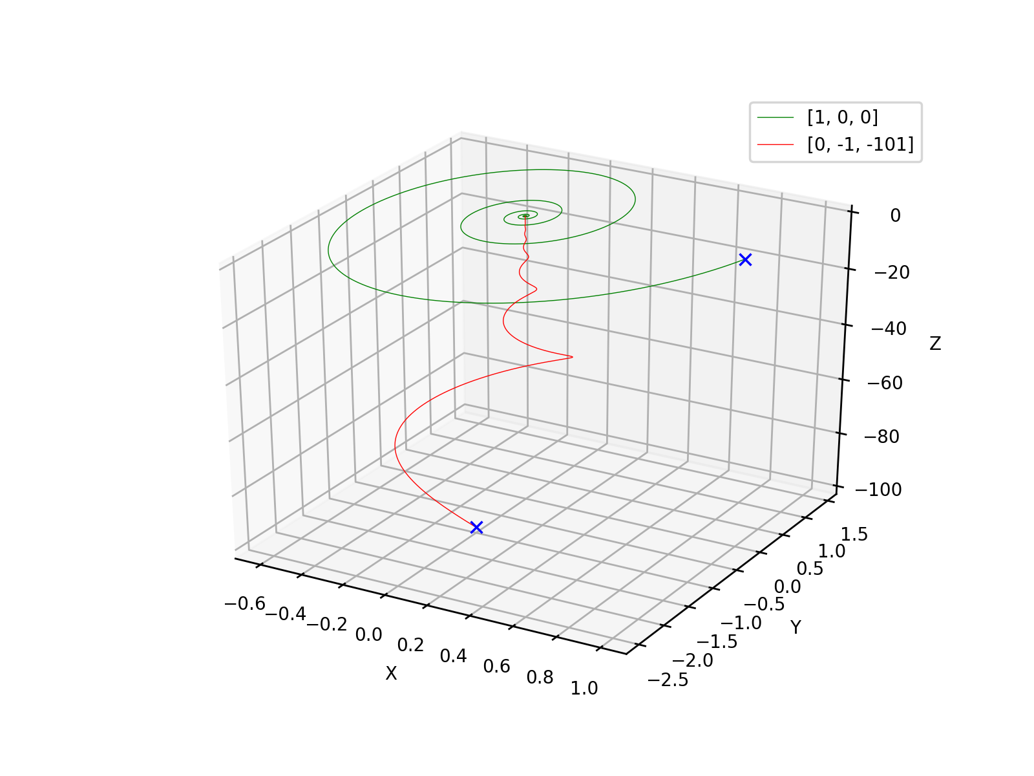
r = -100

Slide 31
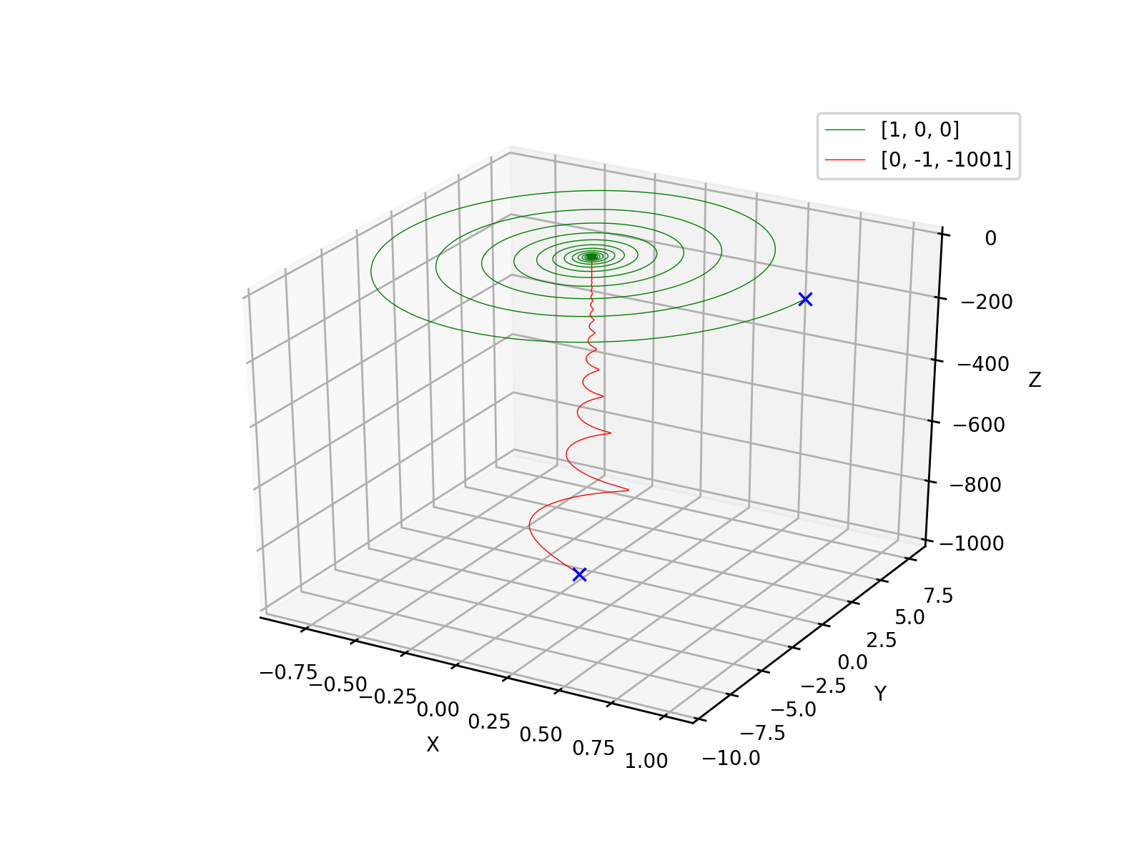
r = -1000

Slide 32
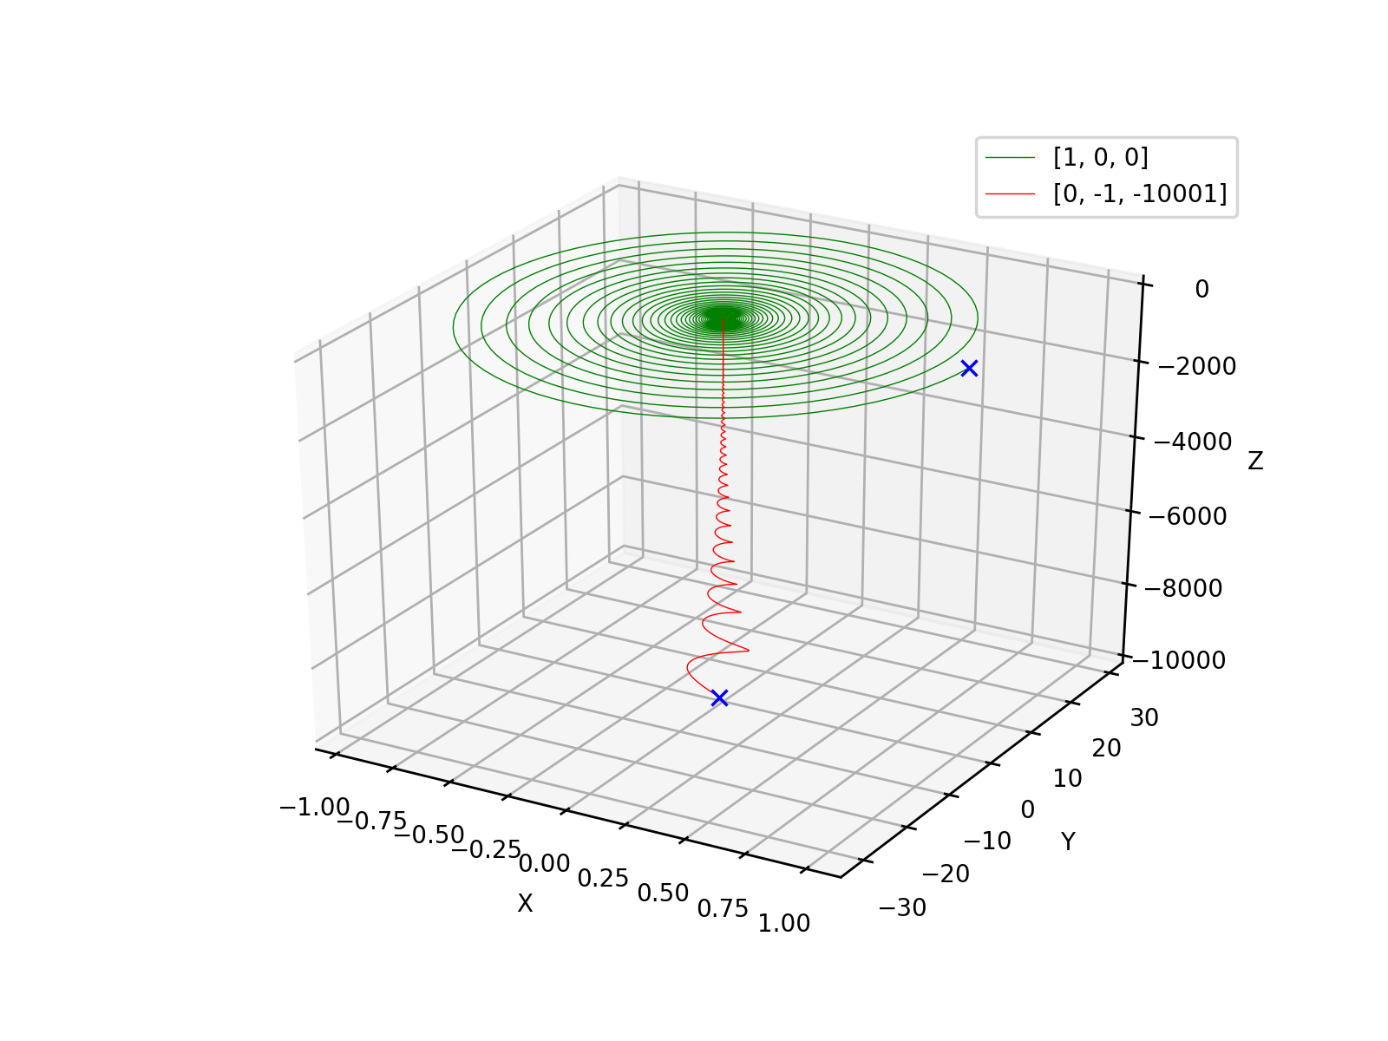
r = -10000

Slide 33
Code Used:
import matplotlib.pyplot as pt
from scipy import integrate
import numpy as np
pt.rcParams.update({'font.size': 8})
a=28
z_val=a-1
def lorenz(vec, t0, s=10, b=8/3, r=a):
(x,y,z)=vec
return [s*(y-x), x*(r-z)-y, x*y-b*z]
x_0 = [1,-1,20]
ti=0
tf=100
nsteps=25000
t = np.linspace(ti, tf, nsteps)
xt = integrate.odeint(lorenz, x_0, t)
j=[row[0] for row in xt]
k=[row[1] for row in xt]
l=[row[2] for row in xt]
for i in range(nsteps-1):
if l[i] < z_val < l[i+1] or l[i] > z_val > l[i+1]:
continue
else:
j[i], k[i] = 'a', 'a’
if not z_val*0.95 < l[-1] < z_val*1.05:
j[-1], k[-1] = 'a', 'a’
i = 0
while 'a' in j:
if j[i] == 'a':
del j[i]
del k[i]
del l[i]
else:
i += 1
pt.ylim(-29,29)
pt.xlim(-19,19)
pt.ylabel('y')
pt.xlabel('x')
pt.title('r=''{}'.format(nsteps))pt.plot(j, k, 'b+', markersize = 4)
pt.savefig('{}'.format(nsteps), format = 'jpg', dpi=250)

Slide 34
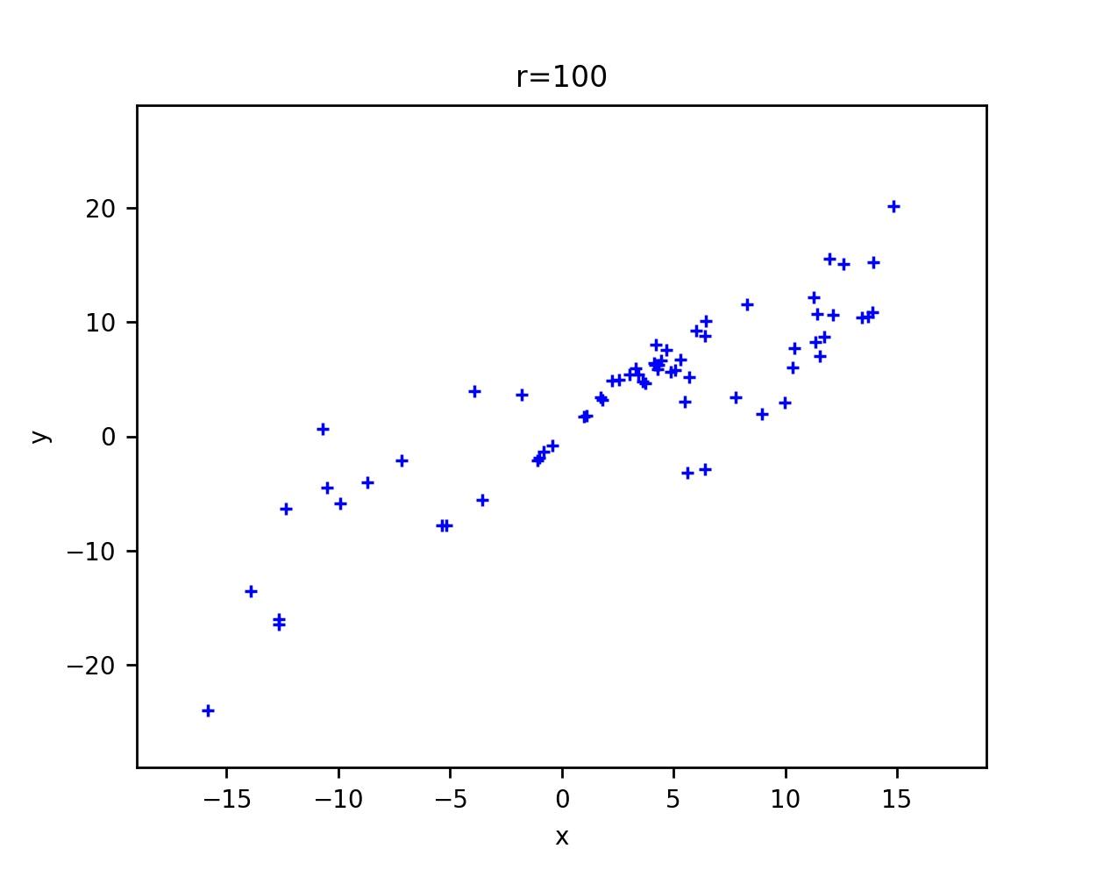


Slide 35
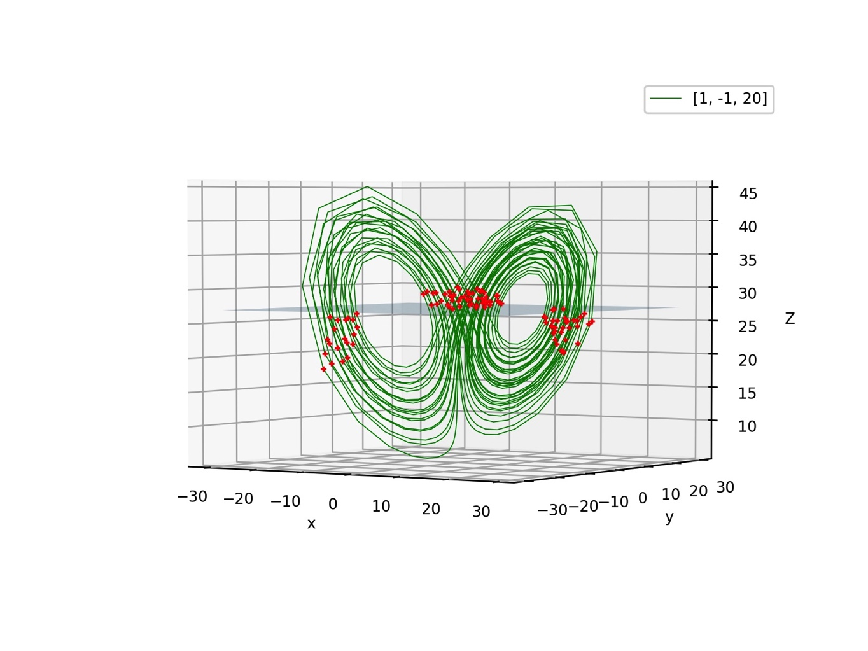
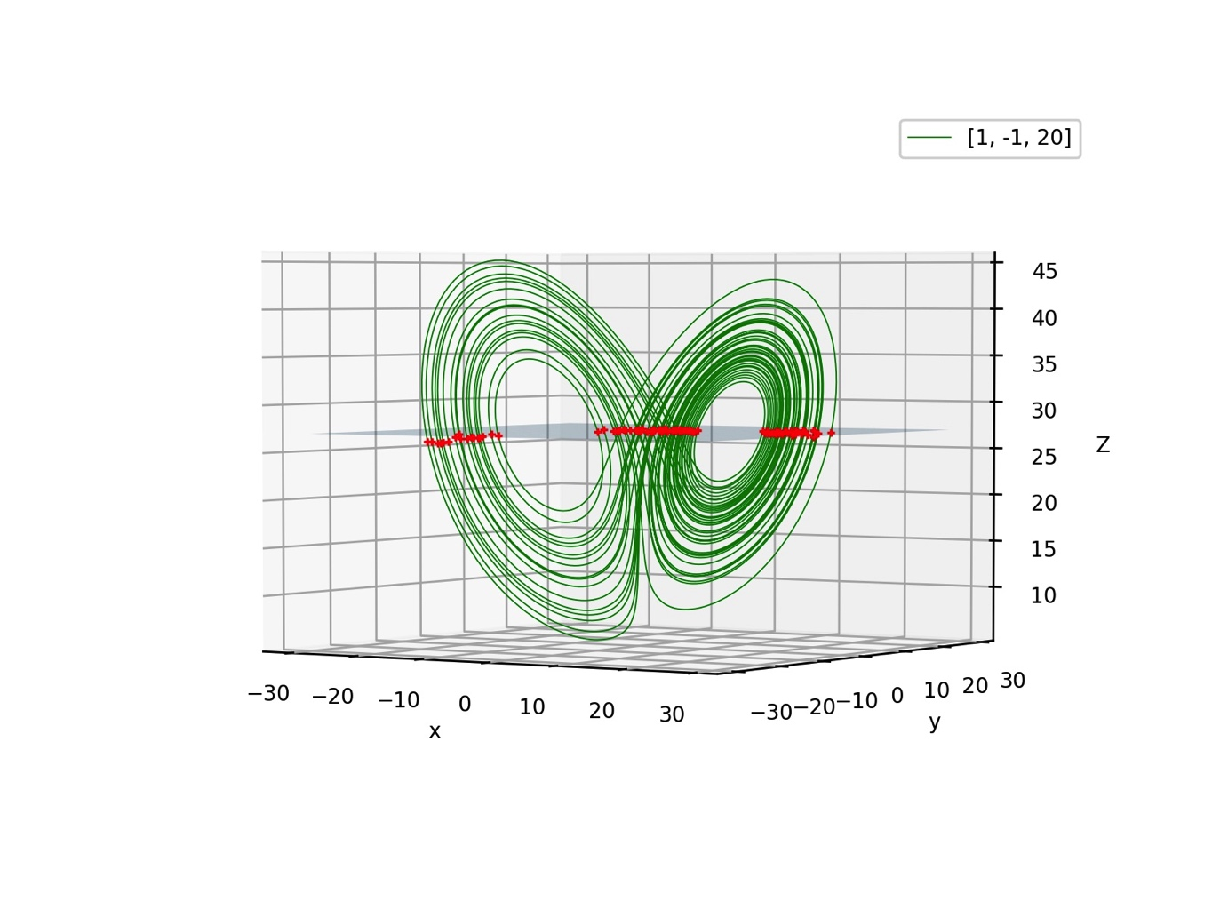
ns = 1000
ns = 10000

Slide 36
r = 5

Slide 37
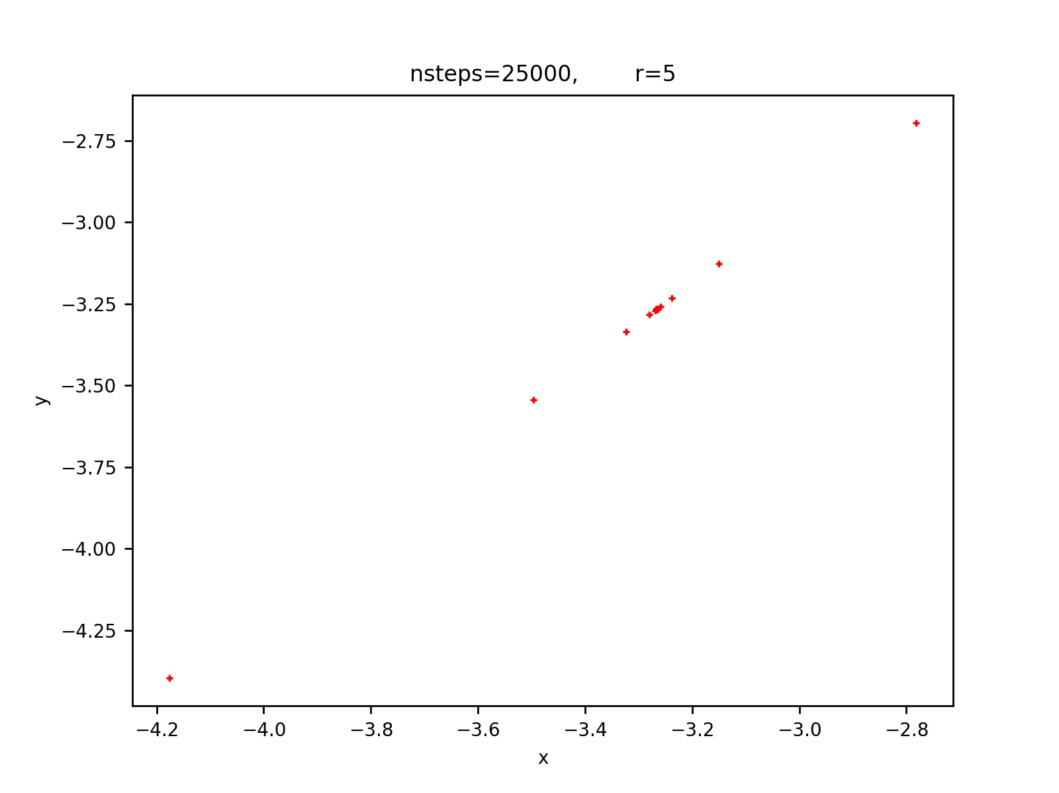

Slide 38
r = 20

Slide 39
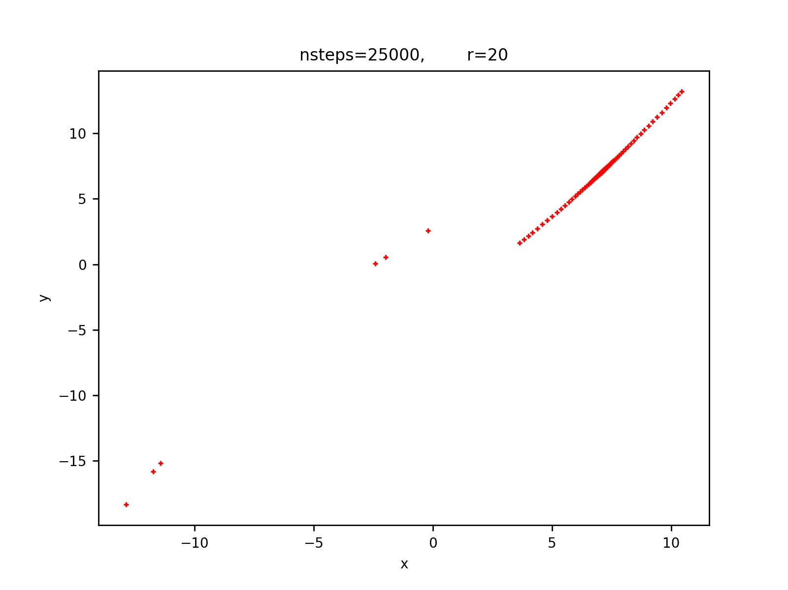

Slide 40
r = 400

Slide 41
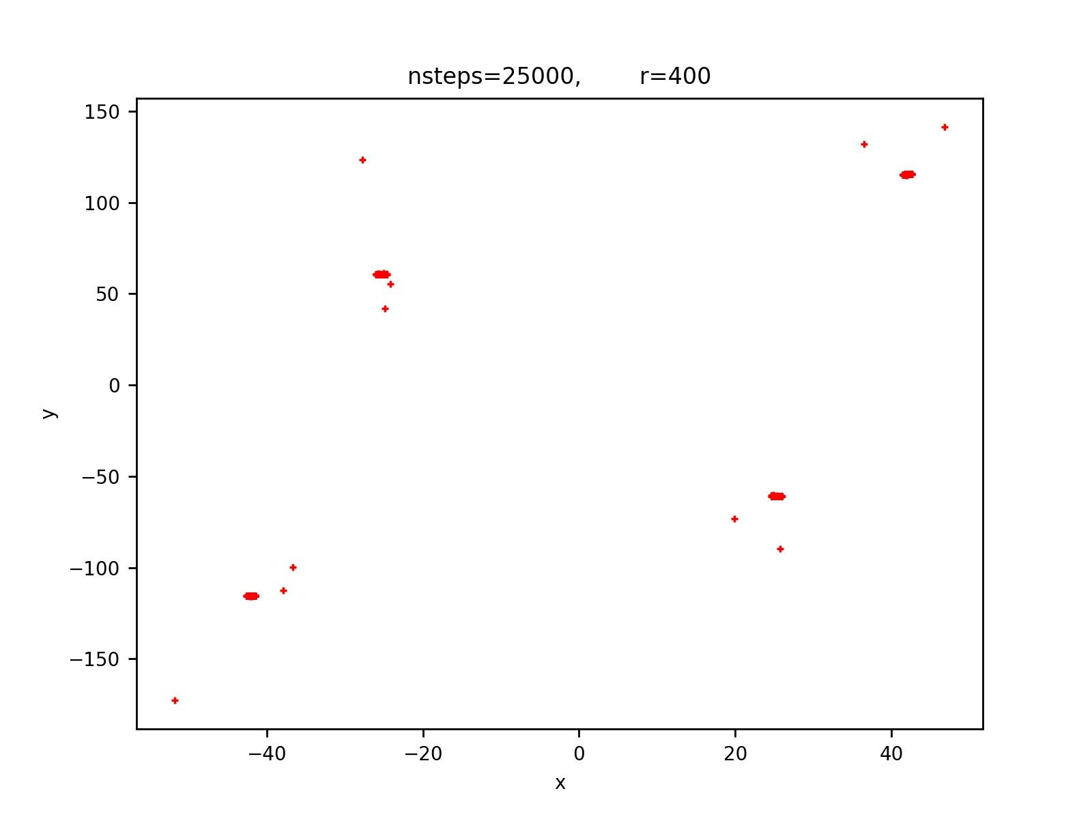
r = 400

